Slide 1

Lesson 1: Plotting
Teacher
25 – 30 minutes

Slide 2
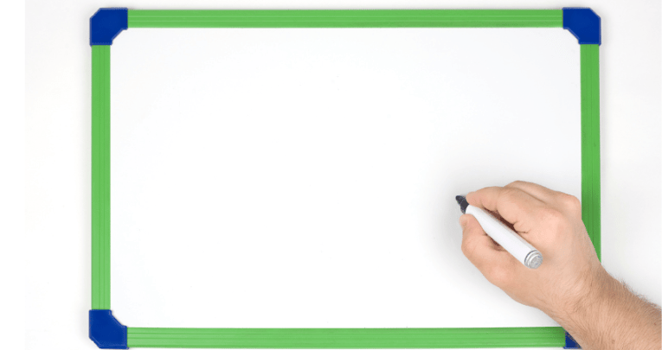
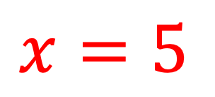
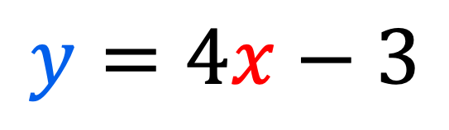
Substituting
Substituting means to replace a letter with its value.
$$x=5$$
$$y=4x−3$$

Slide 3
If $x=4,$ what is the value of $y=3x+10?$

Slide 4
If $x=−3,$ what is the value of $y=2x+18?$

Slide 5
If $y=10$ and $y=4x−2,$ what is the value of $x?$
!
!

Slide 6
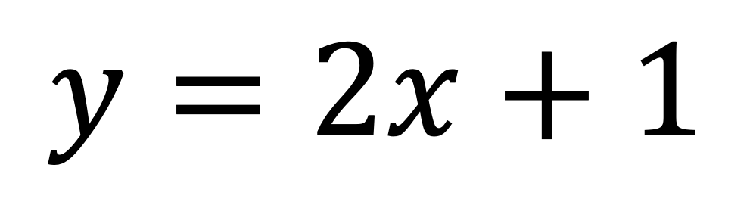
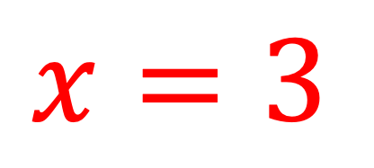
$$y=2x+1$$
$$x=3$$

Slide 7
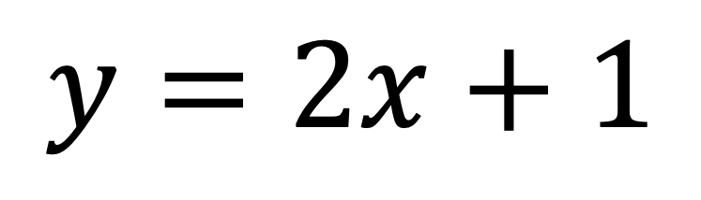
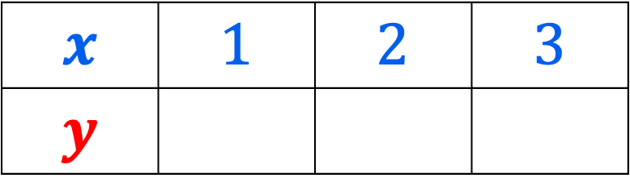
$$y=2x+1$$
8
7
6
5
4
3
2
1
0
-1
-2
-3
$$x$$ | $$1$$ | $$2$$ | $$3$$
$$y$$
-4 | -3 | -2 | -1 | 0 | 1 | 2 | 3 | 4 | 5 | 6 | 7 | 8
Notes:
“Let us begin by considering the equation y=2x+1

Slide 8
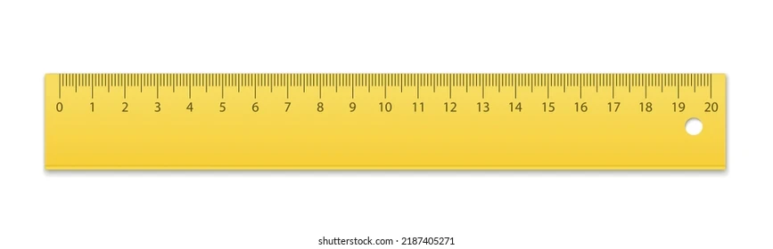

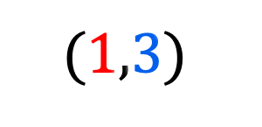
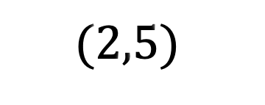
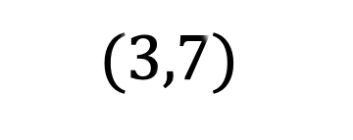
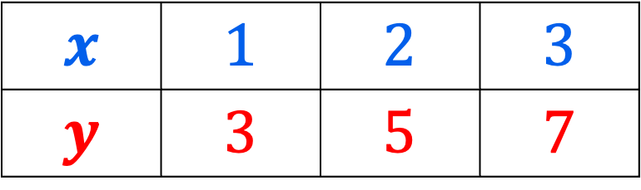
$$y=2x+1$$
8
7
6
5
4
3
2
1
-1
-2
-3
$$(3,7)$$
$$(2,5)$$
$$(1,3)$$
$$x$$ | $$1$$ | $$2$$ | $$3$$
$$y$$ | $$3$$ | $$5$$ | $$7$$
0
-4 | -3 | -2 | -1 |  | 1 | 2 | 3 | 4 | 5 | 6 | 7 | 8
Notes:
“Let us begin by considering the equation y=2x+1

Slide 9
$$y=2x+1$$
8
7
6
5
4
3
2
1
-1
-2
-3
$$(3,7)$$
$$(2,5)$$
$$(1,3)$$
$$x$$ | $$1$$ | $$2$$ | $$3$$
$$y$$ | $$3$$ | $$5$$ | $$7$$
0
-4 | -3 | -2 | -1 |  | 1 | 2 | 3 | 4 | 5 | 6 | 7 | 8
Notes:
“Let us begin by considering the equation y=2x+1

Slide 10
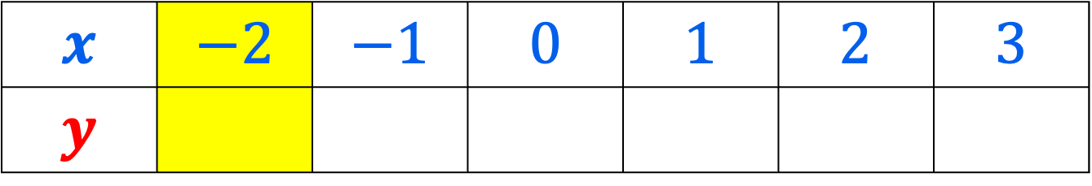
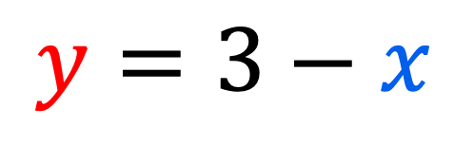
Let’s try another graph.
$$y=3−x$$
$$x$$ | $$−2$$ | $$−1$$ | $$0$$ | $$1$$ | $$2$$ | $$3$$
$$y$$

Slide 11
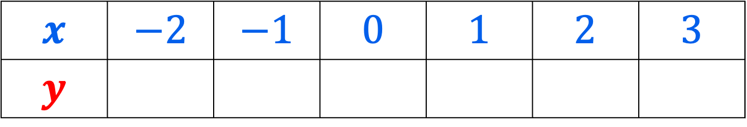
Let’s try another graph.
$$y=3−x$$
$$x$$ | $$−2$$ | $$−1$$ | $$0$$ | $$1$$ | $$2$$ | $$3$$
$$y$$

Slide 12

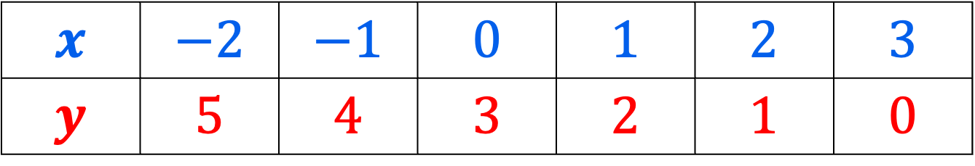
Let’s try another graph.
$$y=3−x$$
$$x$$ | $$−2$$ | $$−1$$ | $$0$$ | $$1$$ | $$2$$ | $$3$$
$$y$$ | $$5$$ | $$4$$ | $$3$$ | $$2$$ | $$1$$ | $$0$$
$$4$$

Slide 13
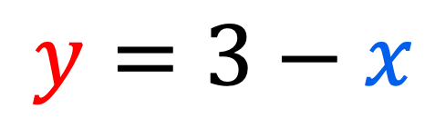
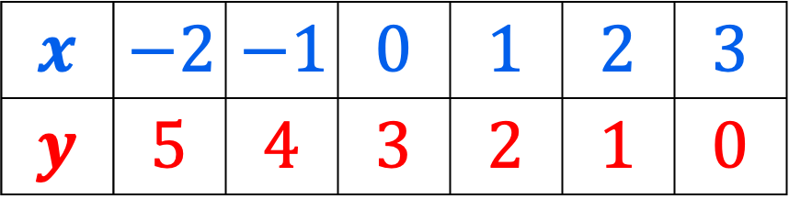
8
7
6
5
4
3
2
1
0
-1
-2
-3
$$y=3−x$$
$$4$$
$$x$$ | $$−2$$ | $$−1$$ | $$0$$ | $$1$$ | $$2$$ | $$3$$
$$y$$ | $$5$$ | $$4$$ | $$3$$ | $$2$$ | $$1$$ | $$0$$
-4 | -3 | -2 | -1 | 0 | 1 | 2 | 3 | 4 | 5 | 6 | 7 | 8

Slide 14
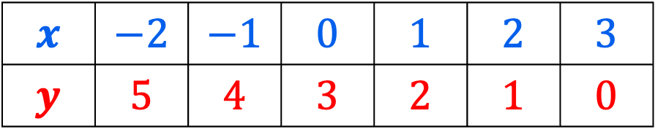
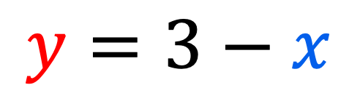
$$y=3−x$$
8
7
6
5
4
3
2
1
0
-1
-2
-3
$$x$$ | $$−2$$ | $$−1$$ | $$0$$ | $$1$$ | $$2$$ | $$3$$
$$y$$ | $$5$$ | $$4$$ | $$3$$ | $$2$$ | $$1$$ | $$0$$
-4 | -3 | -2 | -1 | 0 | 1 | 2 | 3 | 4 | 5 | 6 | 7 | 8

Slide 15

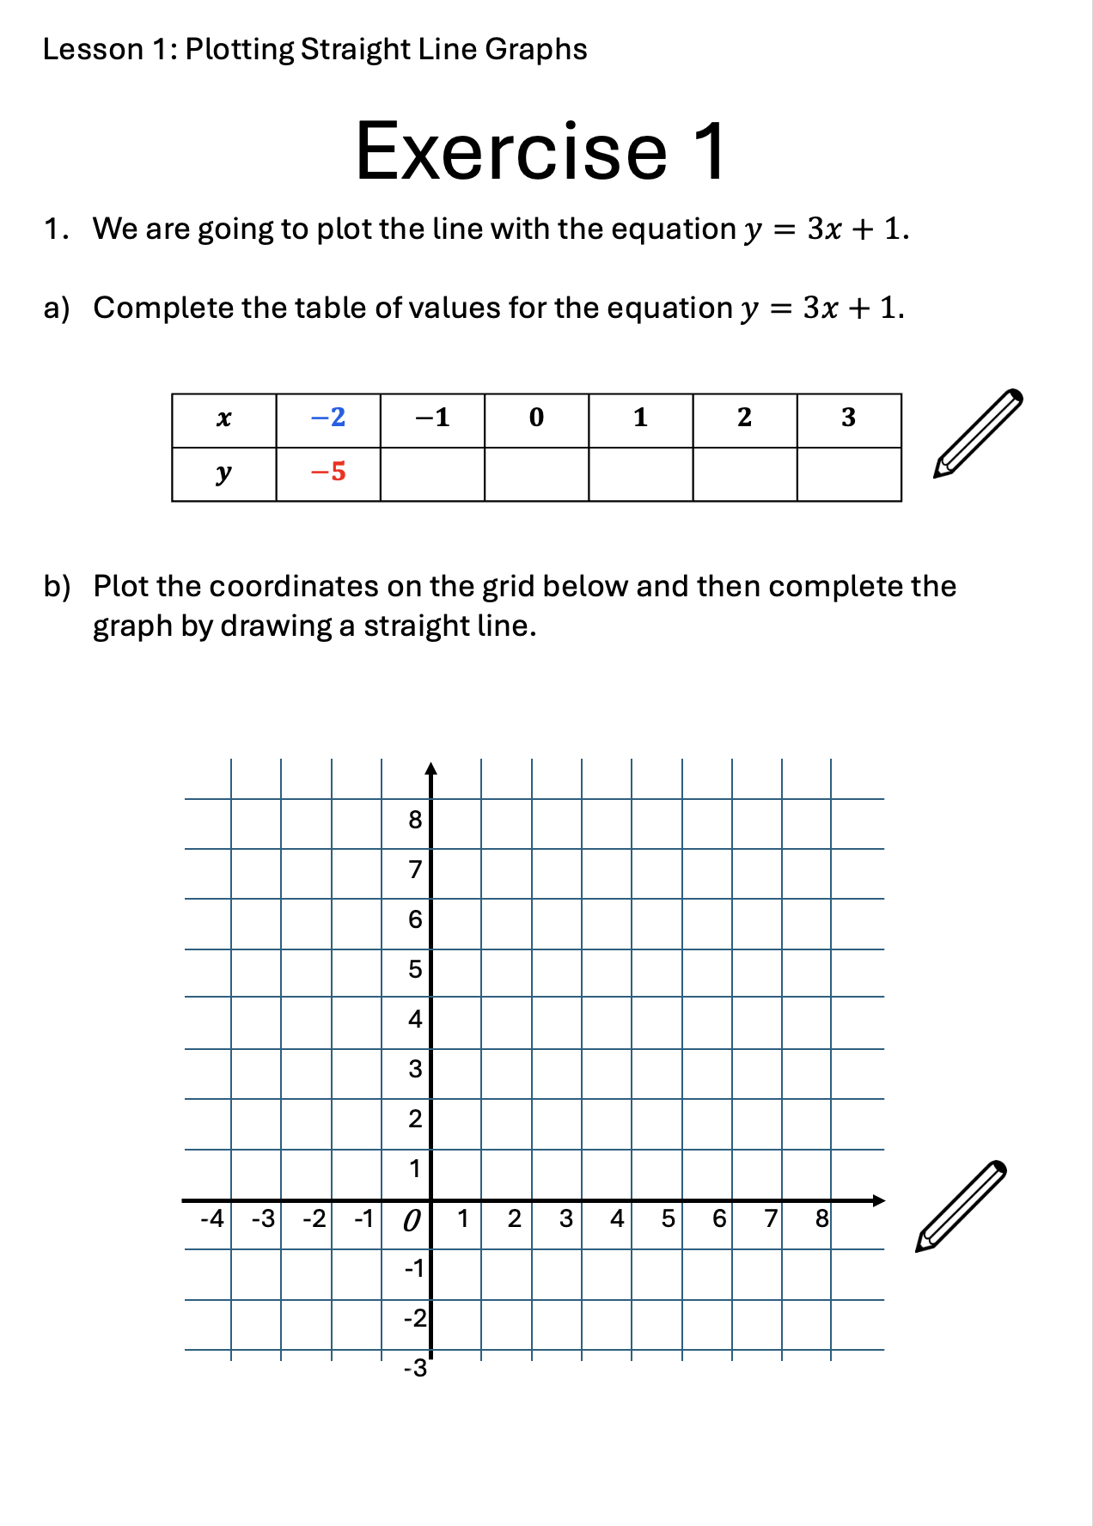

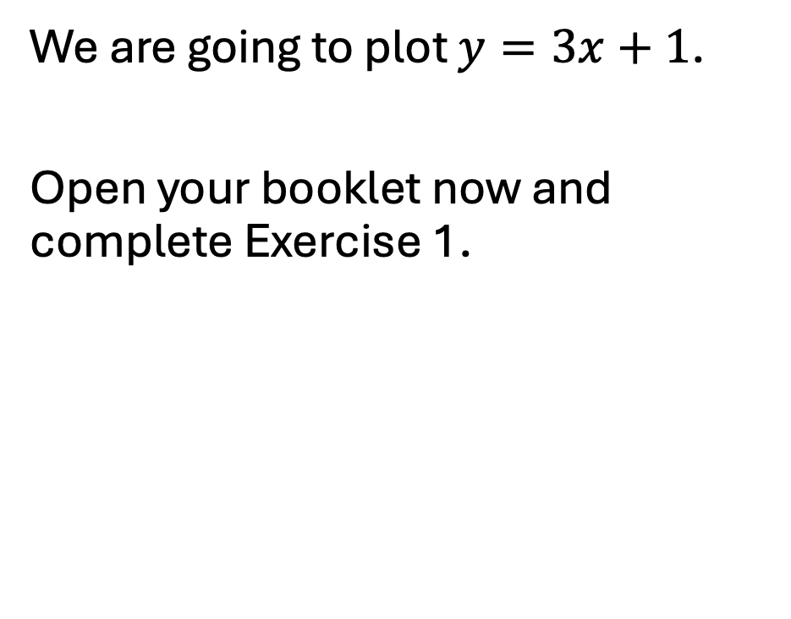
Now you try!
We are going to plot $y=3x+1$.
Open your booklet now and complete Exercise 1.

Slide 16

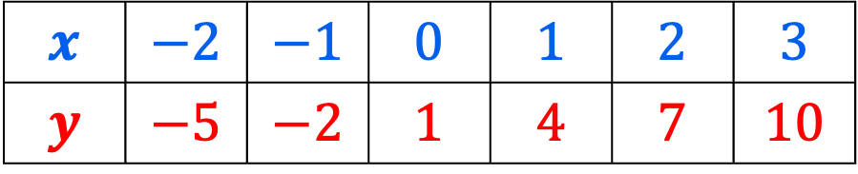
$$y=3x+1$$
8
7
6
5
4
3
2
1
0
-1
-2
-3
$$x$$ | $$−2$$ | $$−1$$ | $$0$$ | $$1$$ | $$2$$ | $$3$$
$$y$$ | $$−5$$ | $$−2$$ | $$1$$ | $$4$$ | $$7$$ | $$10$$
-4 | -3 | -2 | -1 | 0 | 1 | 2 | 3 | 4 | 5 | 6 | 7 | 8

Slide 17

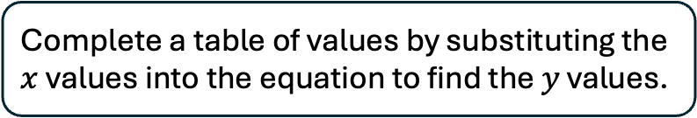
Put these steps in order on your miniwhiteboard, just using the letters A,B and C.
A
Connect the coordinates using a ruler.
B
Plot the pairs of coordinates on a $xy$ grid.
C
Complete a table of values by substituting the $x$ values into the equation to find the $y$ values.

Slide 18
Gemma tried to plot a straight-line graph.
8
7
6
5
4
3
2
1
-1
-2
-3
She made a mistake with one of the coordinates.
Which coordinate has been drawn in the wrong place?
A
B
C
D
0
-4 | -3 | -2 | -1 |  | 1 | 2 | 3 | 4 | 5 | 6 | 7 | 8
E

Slide 19
Gemma tried to plot a straight-line graph.
8
7
6
5
4
3
2
1
-1
-2
-3
Where should this coordinate go?
Write down the correct coordinates.
0
-4 | -3 | -2 | -1 |  | 1 | 2 | 3 | 4 | 5 | 6 | 7 | 8

Slide 20
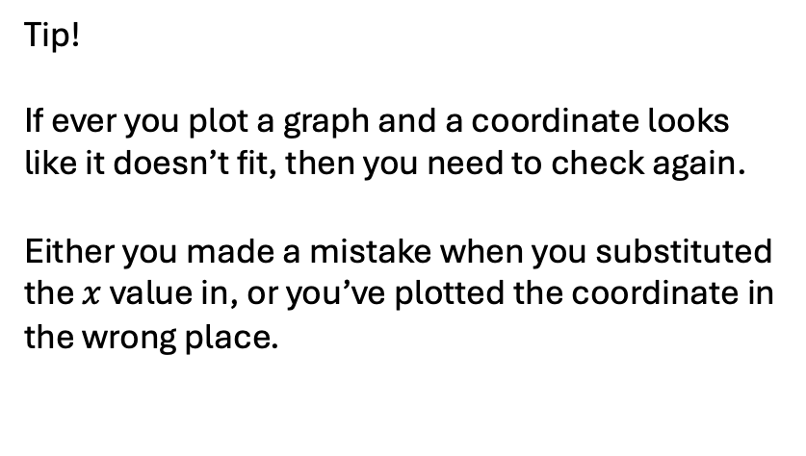
Gemma tried to plot a straight-line graph.
8
7
6
5
4
3
2
1
-1
-2
-3
Tip!
If ever you plot a graph and a coordinate looks like it doesn’t fit, then you need to check again.
Either you made a mistake when you substituted the $x$ value in, or you’ve plotted the coordinate in the wrong place.
0
-4 | -3 | -2 | -1 |  | 1 | 2 | 3 | 4 | 5 | 6 | 7 | 8

Slide 21
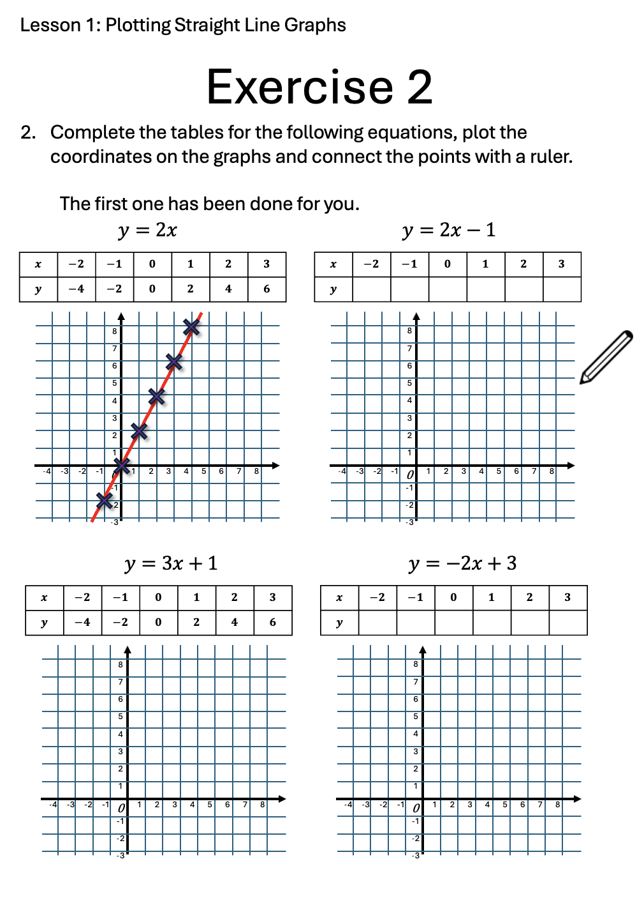
Turn to Exercise 2.
It’s time to practice plotting straight-line graphs.
The first question has been done for you.

Slide 22
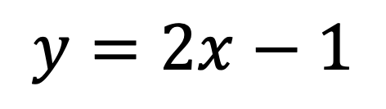
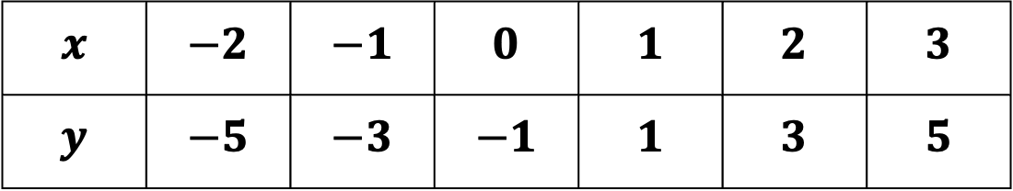
2b)
$$y=2x−1$$
$$x$$ | $$−2$$ | $$−1$$ | $$0$$ | $$1$$ | $$2$$ | $$3$$
$$y$$ | $$−5$$ | $$−3$$ | $$−1$$ | $$1$$ | $$3$$ | $$5$$
8
7
6
5
4
3
2
1
-1
-2
-3
0
-4 | -3 | -2 | -1 |  | 1 | 2 | 3 | 4 | 5 | 6 | 7 | 8

Slide 23
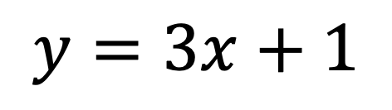
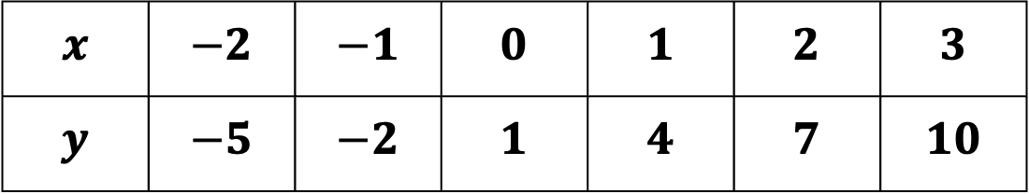
2c)
$$y=3x+1$$
$$x$$ | $$−2$$ | $$−1$$ | $$0$$ | $$1$$ | $$2$$ | $$3$$
$$y$$ | $$−5$$ | $$−2$$ | $$1$$ | $$4$$ | $$7$$ | $$10$$
8
7
6
5
4
3
2
1
-1
-2
-3
0
-4 | -3 | -2 | -1 |  | 1 | 2 | 3 | 4 | 5 | 6 | 7 | 8

Slide 24
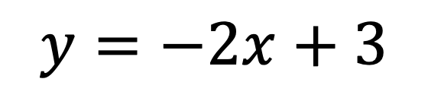
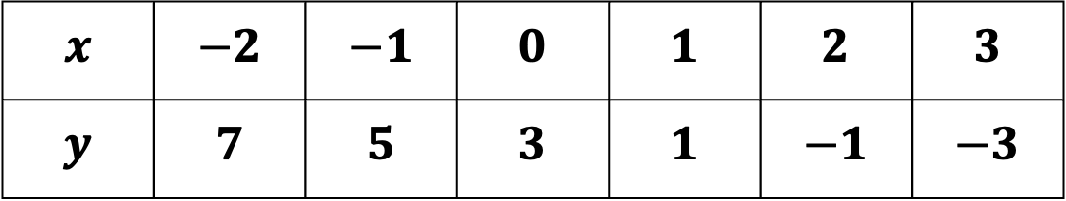
2d)
$$y=−2x+3$$
$$x$$ | $$−2$$ | $$−1$$ | $$0$$ | $$1$$ | $$2$$ | $$3$$
$$y$$ | $$7$$ | $$5$$ | $$3$$ | $$1$$ | $$−1$$ | $$−3$$
8
7
6
5
4
3
2
1
-1
-2
-3
0
-4 | -3 | -2 | -1 |  | 1 | 2 | 3 | 4 | 5 | 6 | 7 | 8

Slide 25
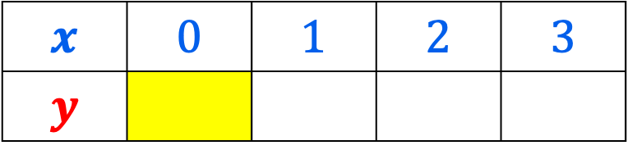
Working backwards…
8
7
6
5
4
3
2
1
0
-1
-2
-3
Look at the graph.
Complete the table of values from the graph.
$$x$$ | $$0$$ | $$1$$ | $$2$$ | $$3$$
$$y$$
-4 | -3 | -2 | -1 | 0 | 1 | 2 | 3 | 4 | 5 | 6 | 7 | 8

Slide 26
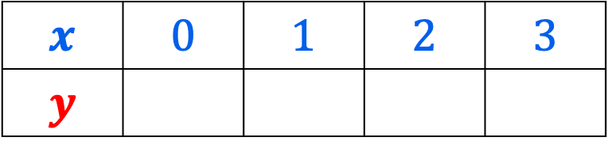
Working backwards…
8
7
6
5
4
3
2
1
0
-1
-2
-3
Look at the graph.
Complete the table of values from the graph.
$$x$$ | $$0$$ | $$1$$ | $$2$$ | $$3$$
$$y$$
-4 | -3 | -2 | -1 | 0 | 1 | 2 | 3 | 4 | 5 | 6 | 7 | 8

Slide 27
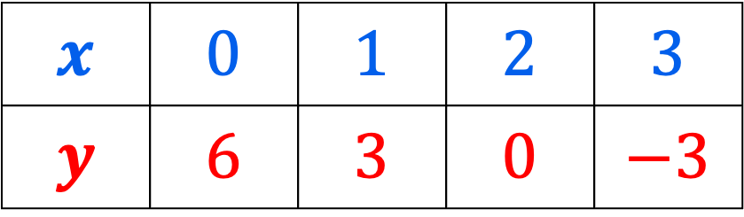
Working backwards…
8
7
6
5
4
3
2
1
0
-1
-2
-3
Look at the graph.
Complete the table of values from the graph.
$$x$$ | $$0$$ | $$1$$ | $$2$$ | $$3$$
$$y$$ | $$6$$ | $$3$$ | $$0$$ | $$−3$$
-4 | -3 | -2 | -1 | 0 | 1 | 2 | 3 | 4 | 5 | 6 | 7 | 8

Slide 28
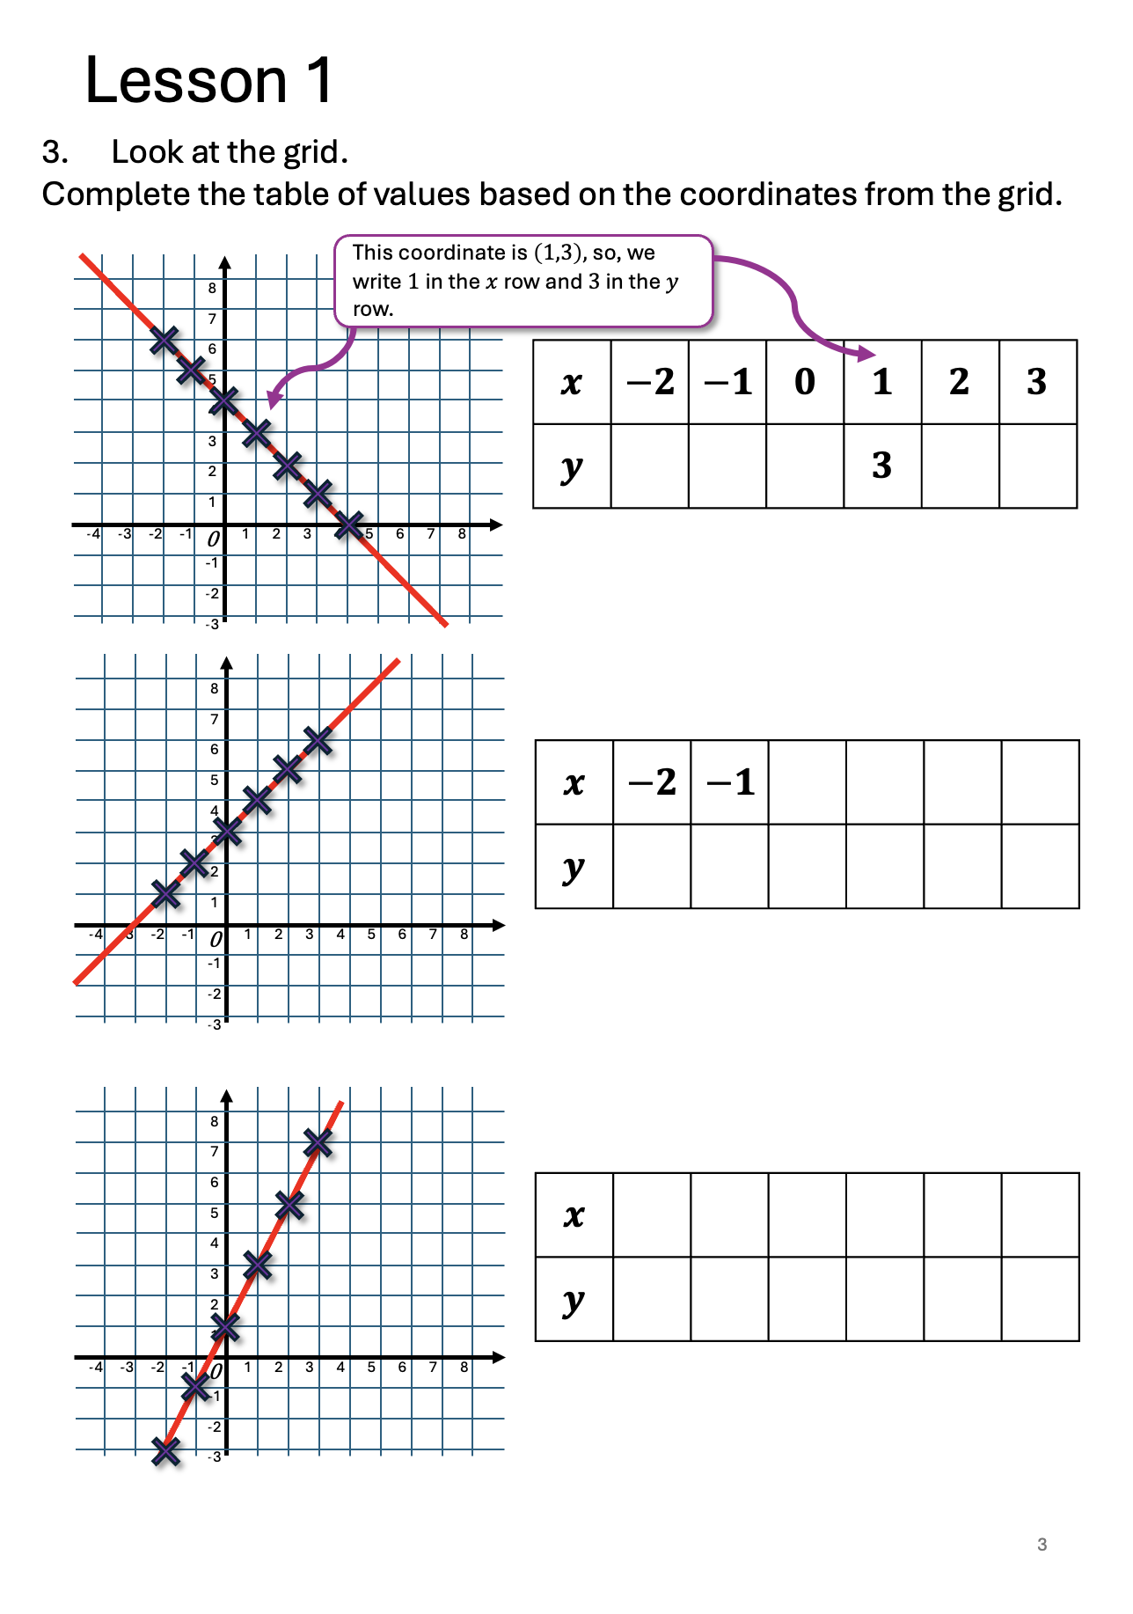
Turn to page 3 in your booklet and complete the questions on this page.
You must complete all questions and check your answers before continuing.

Slide 29
6 5 4 2 1
0 1 2 3
1 2 3 4 5 6
-2 -1 0 1 2 3
-3 -1 1 3 5 7

Slide 30
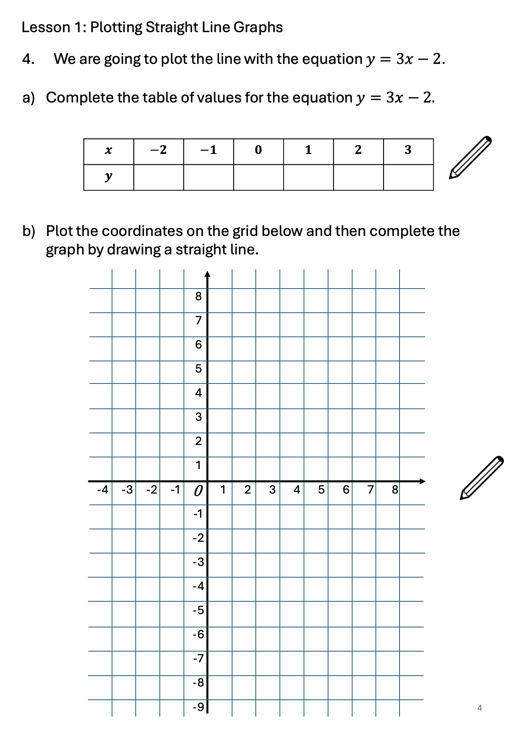
Turn to page 4 in your booklet and complete the questions on this page.
You must complete all questions and check your answers before continuing.

Slide 31
-8 -5 -2 1 4 7

Slide 32

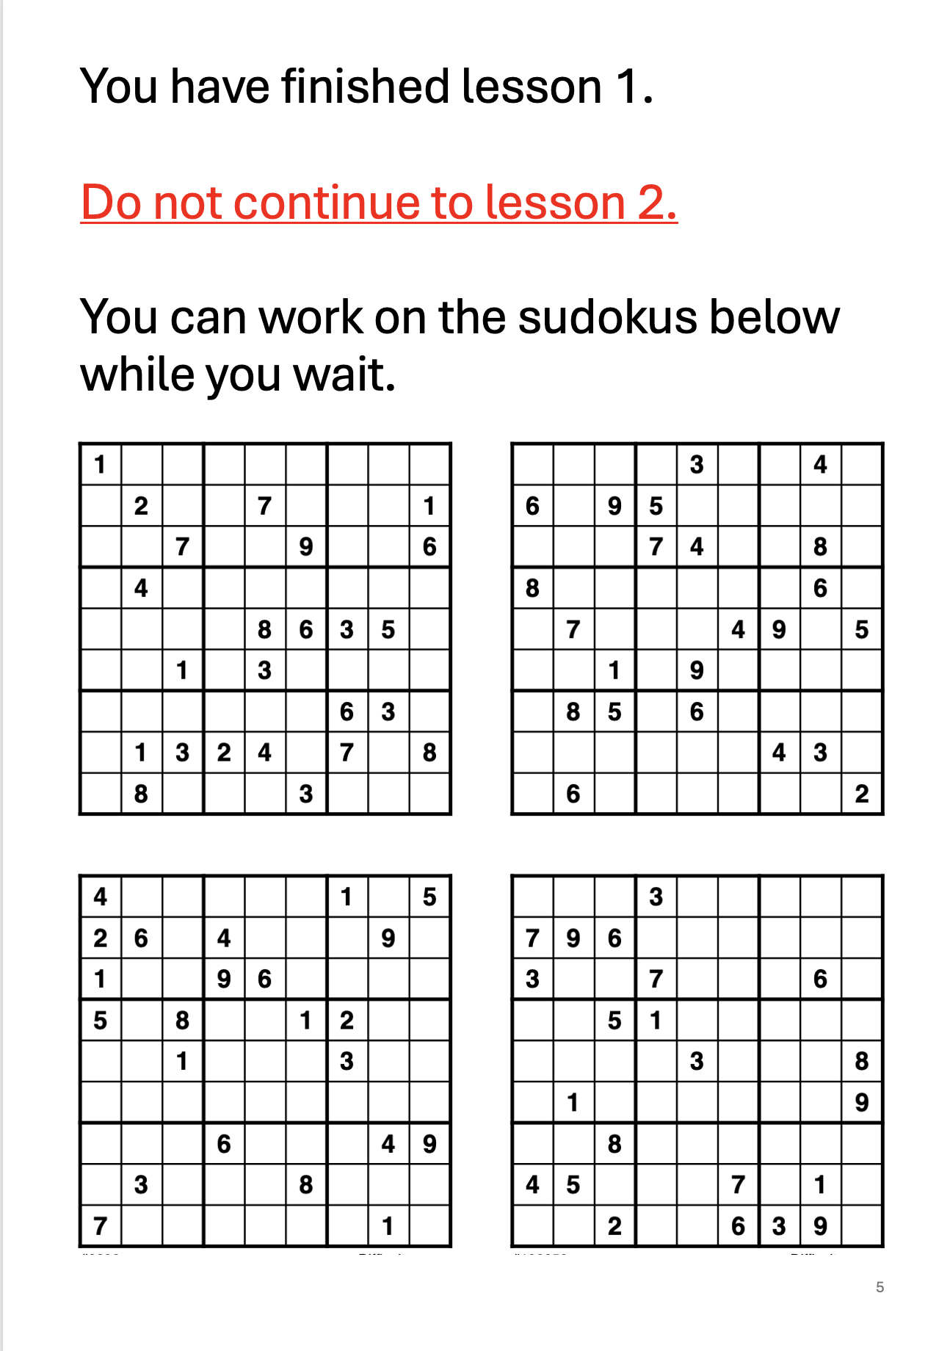
You can now work through the sudokus on page 5 while you wait for everyone else to finish.

