Slide 1

Lesson 2: Gradients
25 – 30 minutes

Slide 2
Notes:
Look at this line.
How would you describe this line?

Slide 3
Notes:
What has changed?

Slide 4
Notes:
How would you describe this line?
How is it different from the previous?

Slide 5
Notes:
And this?

Slide 7

We call the steepness of a line it’s gradient.
Positive Steeper
Positive Steep
Flat
Negative Steep
Negative Steeper
The symbol for gradient is $m$.

Slide 8
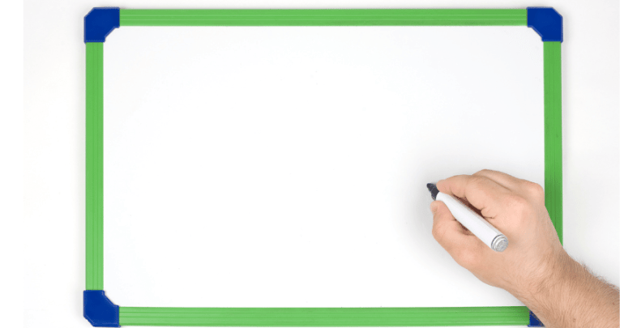
Flat
Positive
Negative

Slide 9
Positive Gradient
Flat
Negative Gradient

Slide 10
Positive Gradient
Flat
Negative Gradient

Slide 11
Positive Gradient
Flat
Negative Gradient

Slide 12
Positive Gradient
Flat
Negative Gradient

Slide 13
Positive Gradient
Flat
Negative Gradient

Slide 14
Positive Gradient
Flat
Negative Gradient

Slide 15
That’s right! 👏
Positive Gradient
Flat
Negative Gradient

Slide 16
Positive Gradient
Flat
Negative Gradient

Slide 17
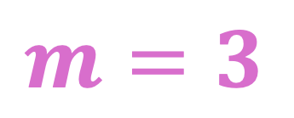
This line has a gradient of 3.
3 up
$$m=3$$
1 across

Slide 18
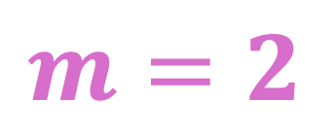
This line has a gradient of 2.
$$m=2$$
2 up
1 across

Slide 19

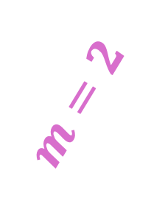
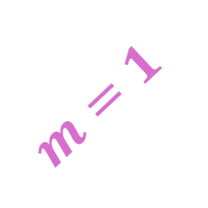
$$m=1$$
$$m=2$$
$$m=3$$
3 up
2 up
1 up
1 across
1 across
1 across

Slide 20
m =

Slide 21
Notes:
What is the gradient? (miniwhiteboards)

Slide 22
Notes:
What is the gradient? (miniwhiteboards)

Slide 23
Notes:
What is the gradient? (miniwhiteboards)

Slide 24
Notes:
What is the gradient? (miniwhiteboards)

Slide 25
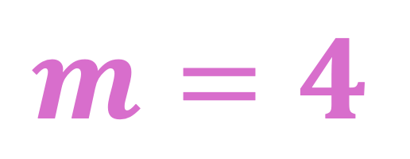
$$m=4$$
Positive Gradient

Slide 26

$$m=2$$
Positive Gradient

Slide 27

$$m=1$$
Positive Gradient

Slide 28
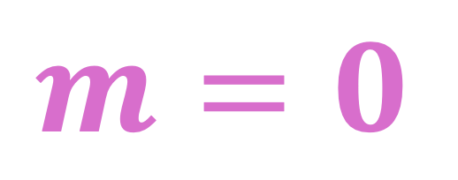
1 across
$$m=0$$
0 up
Flat

Slide 29
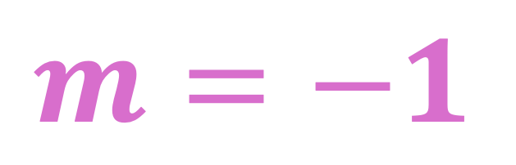
1 across
-1 down
$$m=−1$$
Negative Gradient

Slide 30
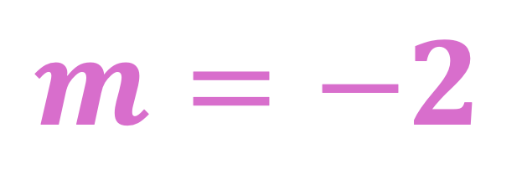
1 across
-2 down
$$m=−2$$
Negative Gradient

Slide 31

1 across
-3 down
$$m=−3$$
Negative Gradient

Slide 32
m =

Slide 33
Notes:
What is the gradient? (miniwhiteboards)

Slide 34
Notes:
What is the gradient? (miniwhiteboards)

Slide 35
Notes:
What is the gradient? (miniwhiteboards)

Slide 36
Notes:
What is the gradient? (miniwhiteboards)

Slide 37
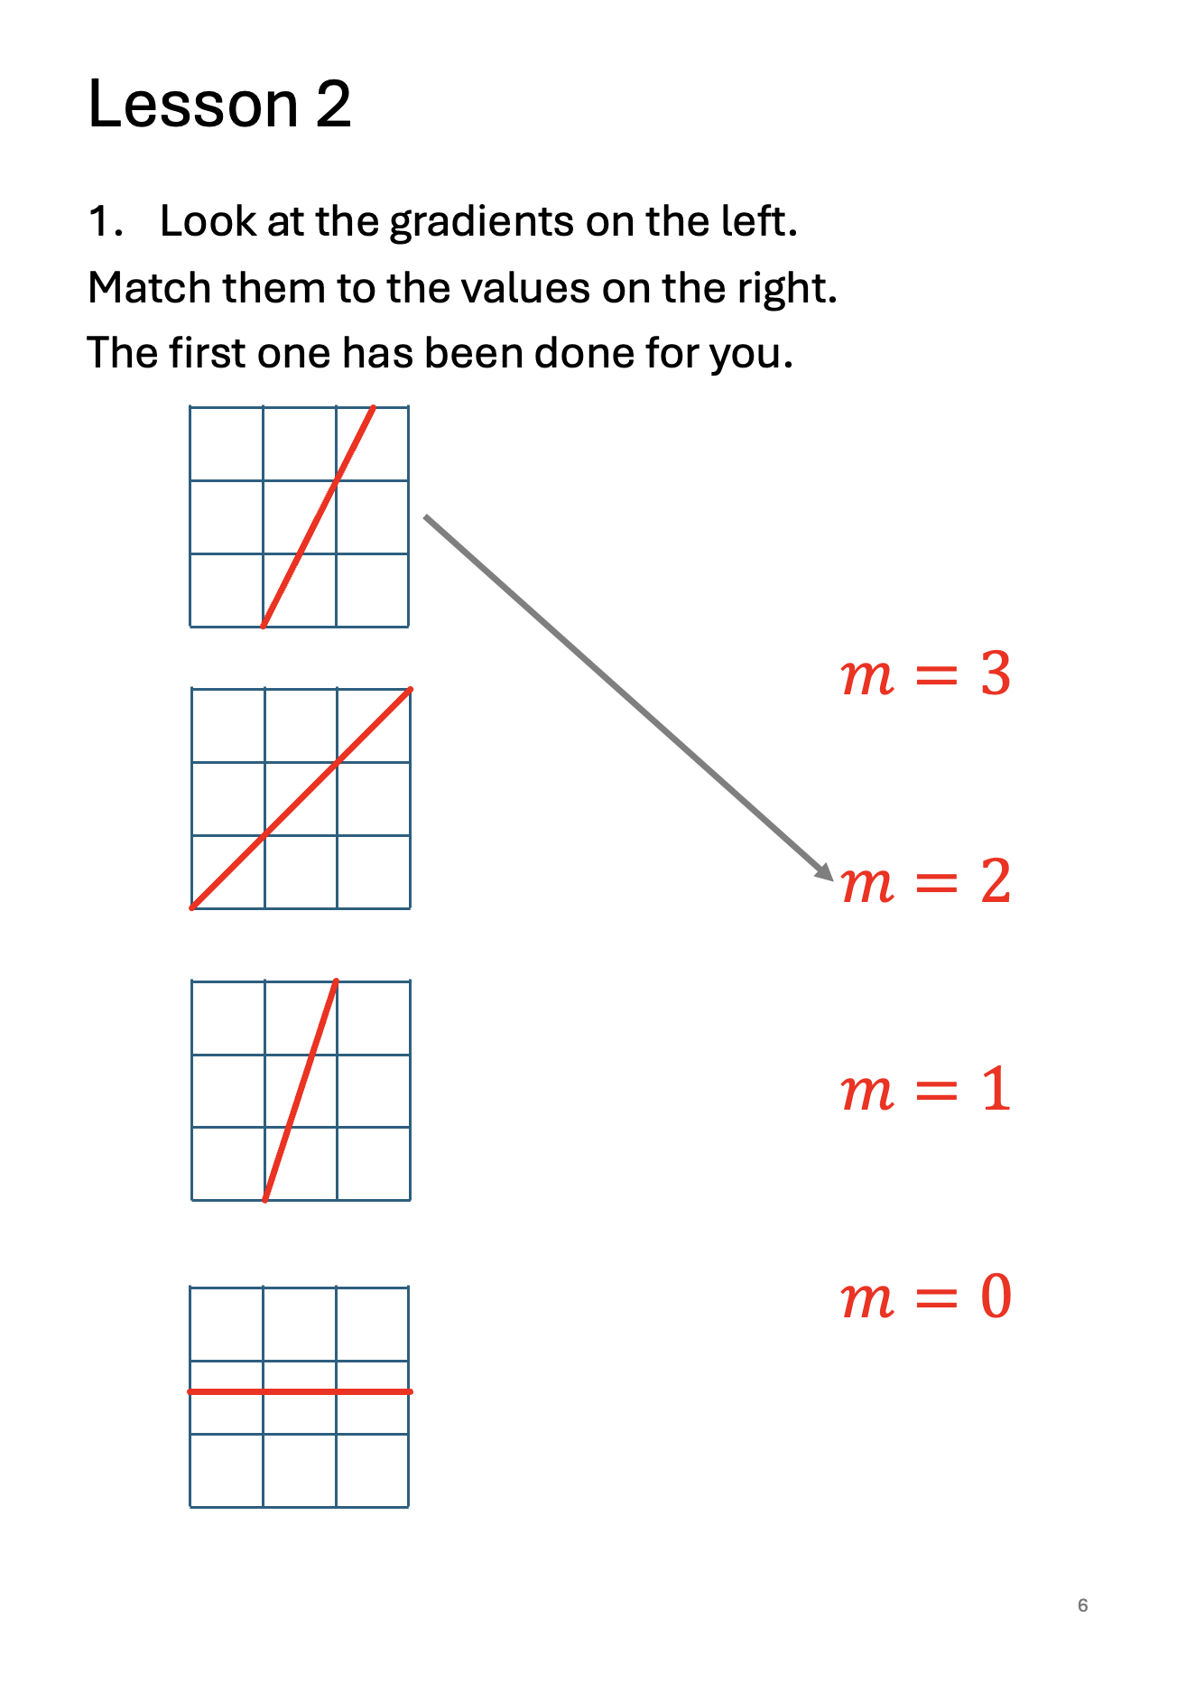
Turn to page 6 in your booklet and complete the questions on this page.
You must complete all questions and check your answers before continuing.

Slide 38
$$1$$
$$1$$

Slide 39
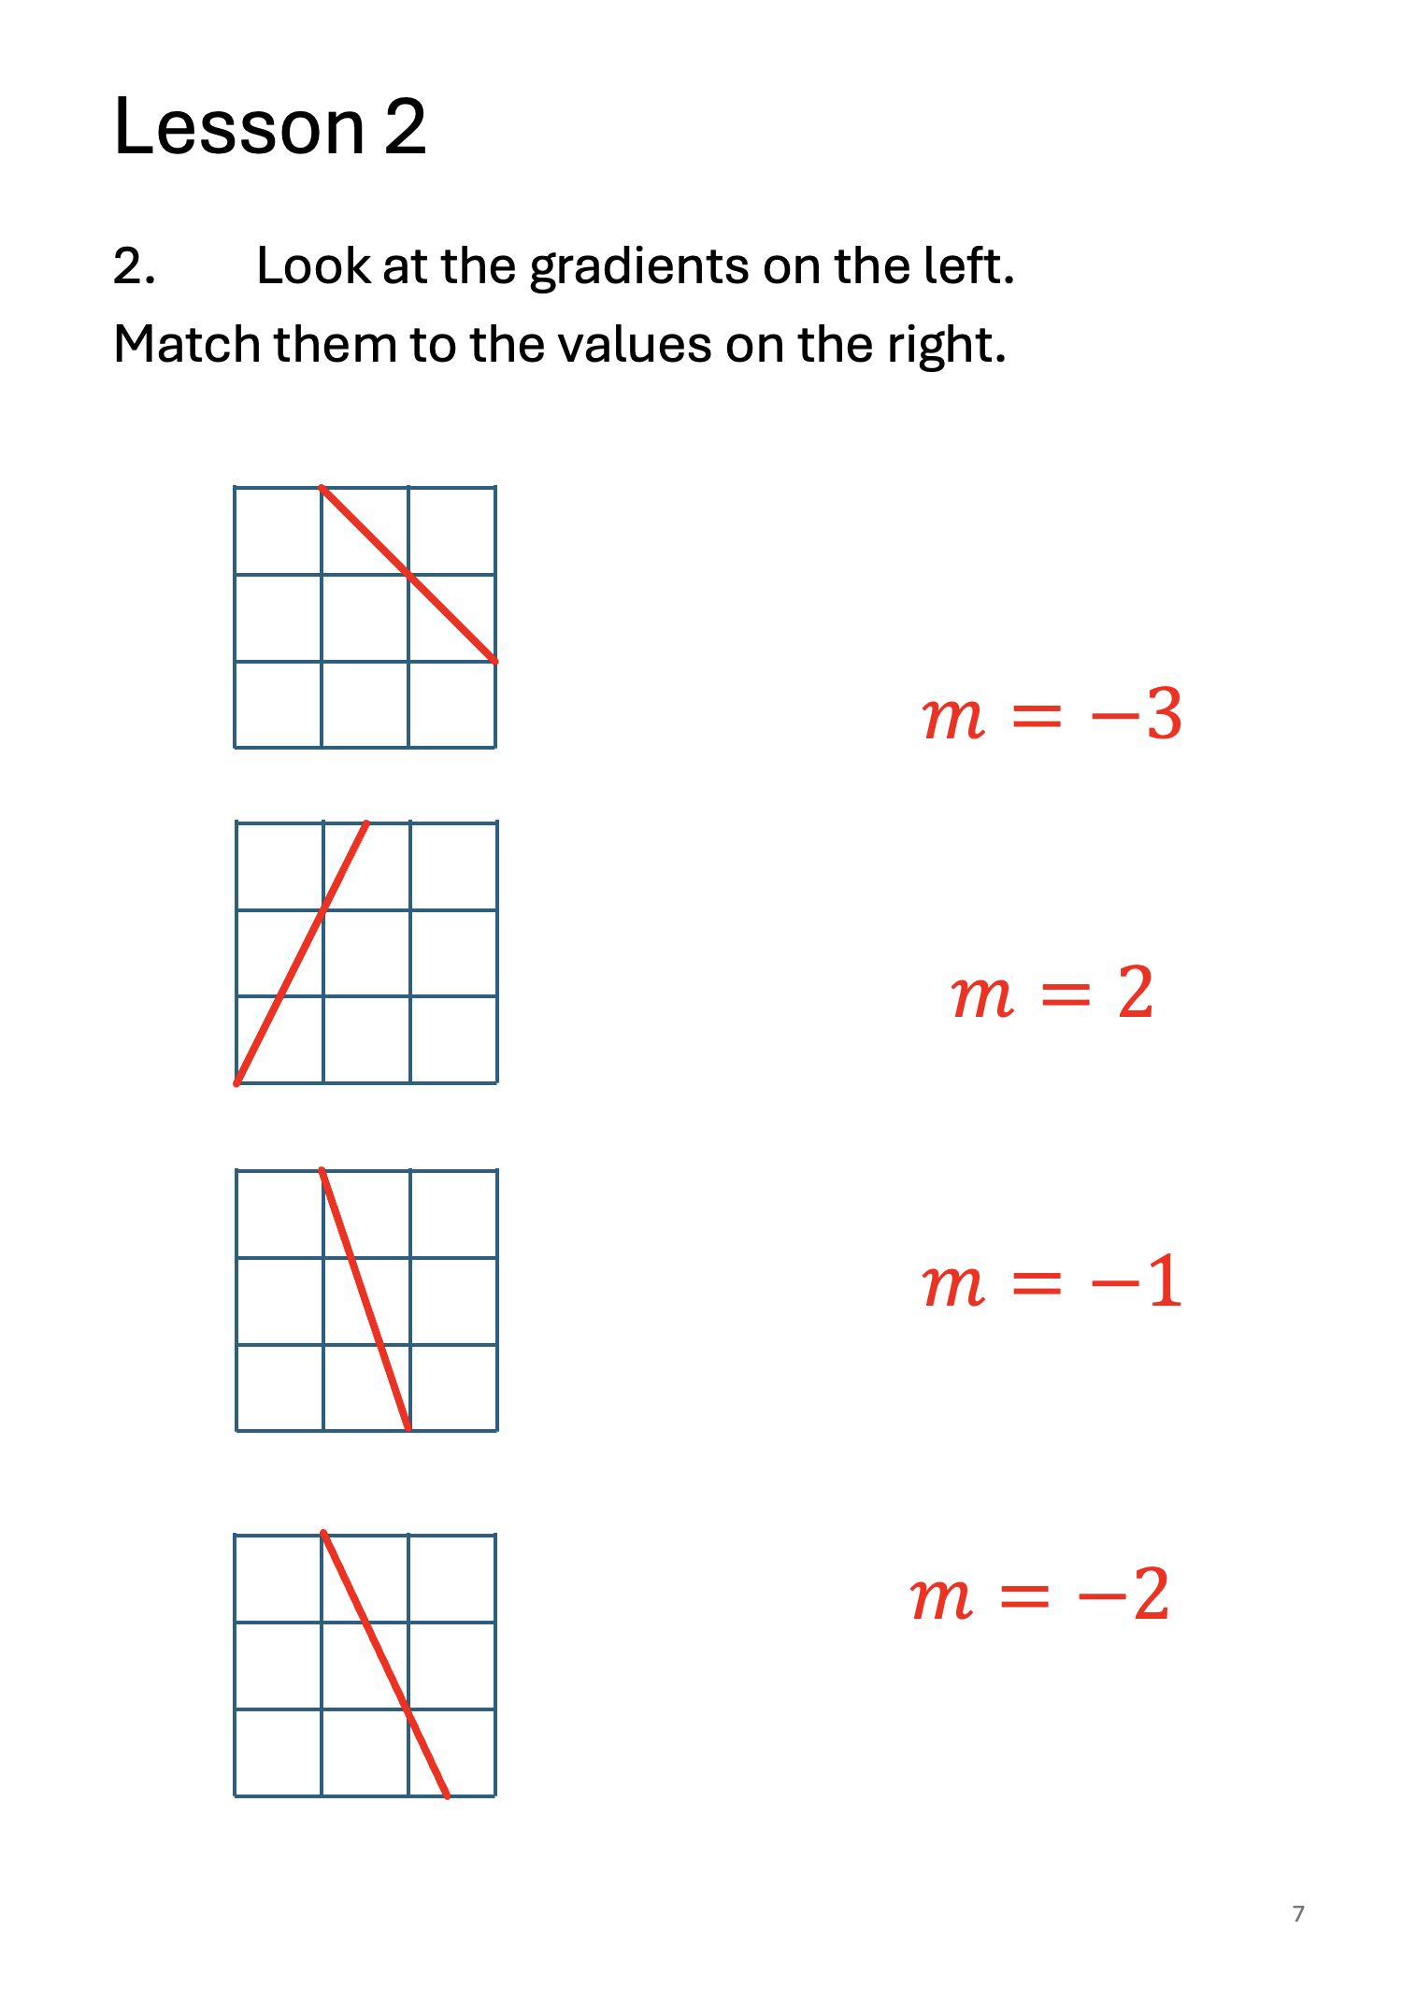
Turn to page 7 in your booklet and complete the questions on this page.
You must complete all questions and check your answers before continuing.

Slide 41
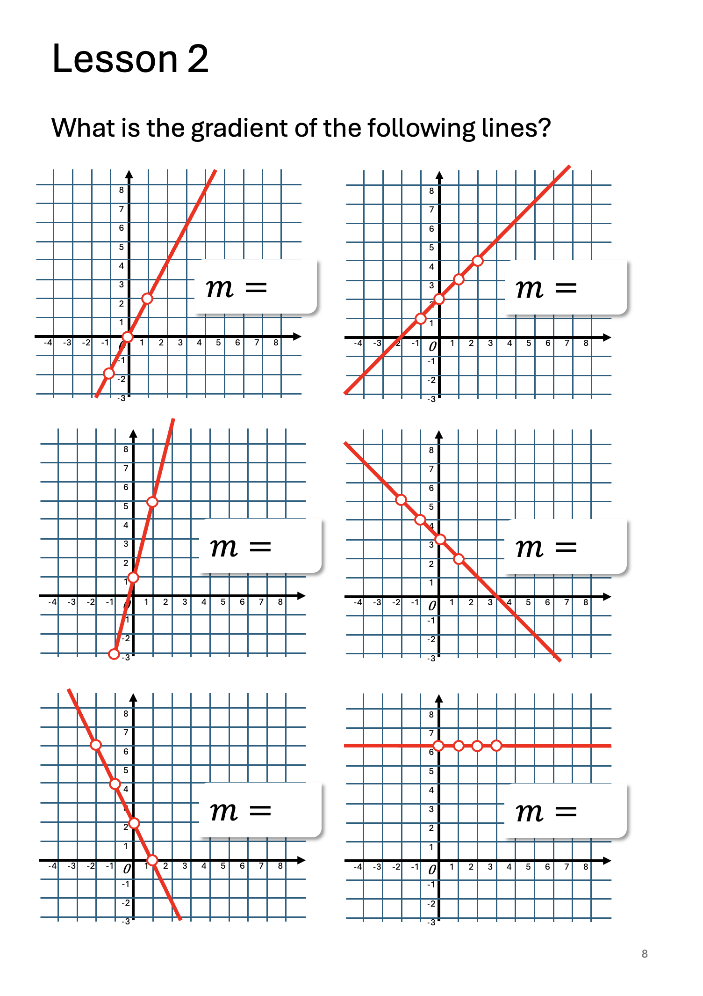
Turn to page 8 in your booklet and complete the questions on this page.
You must complete all questions and check your answers before continuing.

Slide 42
2
1
4
-1
-2
0

Slide 43
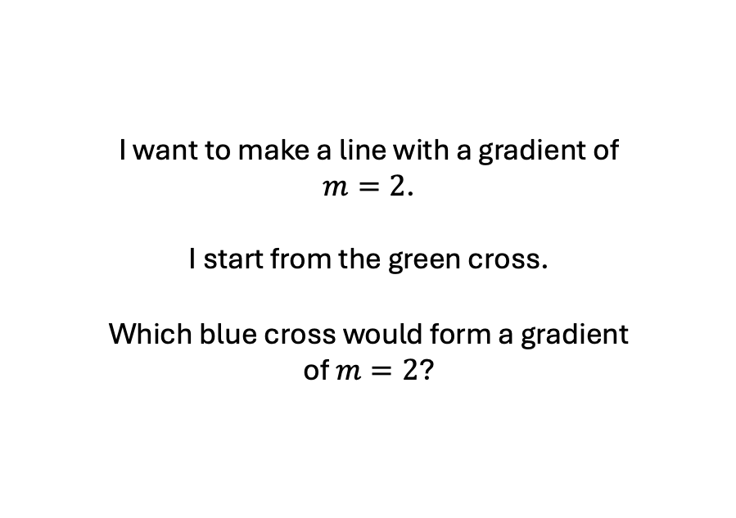
Now, let’s think about gradients differently…
A
B
I want to make a line with a gradient of $m=2$.
I start from the green cross.
Which blue cross would form a gradient of $m=2$?
C
D
E

Slide 44
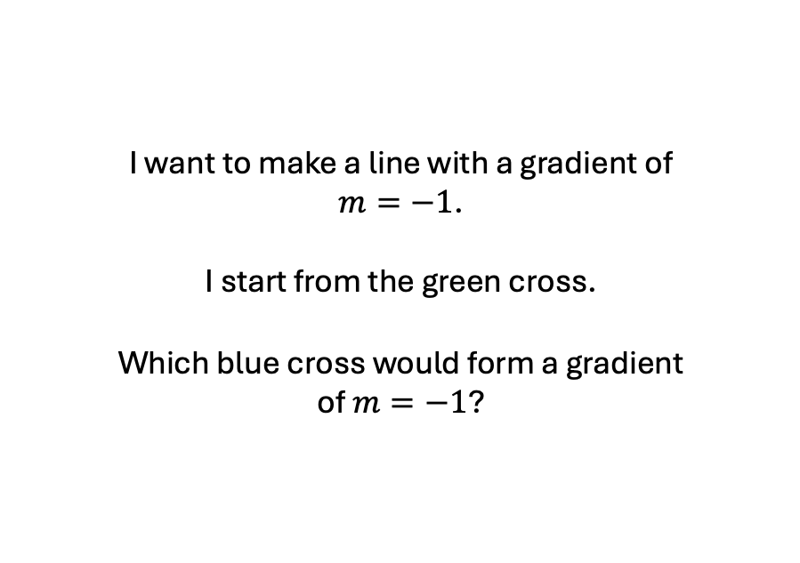
Now, let’s think about gradients differently…
A
B
I want to make a line with a gradient of $m=−1$.
I start from the green cross.
Which blue cross would form a gradient of $m=−1$?
C
D
E

Slide 45
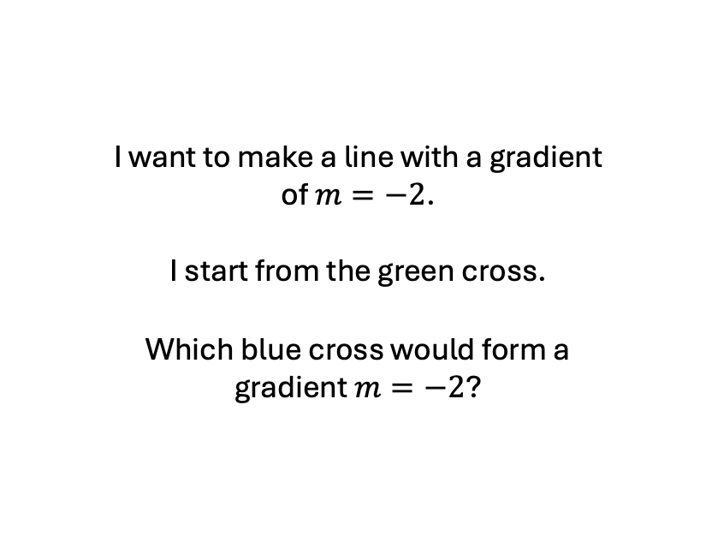
A
B
I want to make a line with a gradient of $m=−2$.
I start from the green cross.
Which blue cross would form a gradient $m=−2$?
C
D
E

Slide 46
Let’s think about this on a graph.
8
7
6
5
4
3
2
1
0
-1
-2
-3
What is the gradient of this line?
-4 | -3 | -2 | -1 | 0 | 1 | 2 | 3 | 4 | 5 | 6 | 7 | 8

Slide 47
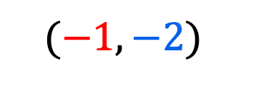
There is a pattern in the coordinates.
8
7
6
5
4
3
2
1
0
-1
-2
-3
-4 | -3 | -2 | -1 | 0 | 1 | 2 | 3 | 4 | 5 | 6 | 7 | 8
$$(−1,−2)$$

Slide 48

There is a pattern in the coordinates.
8
7
6
5
4
3
2
1
0
-1
-2
-3
$$(0,1)$$
-4 | -3 | -2 | -1 | 0 | 1 | 2 | 3 | 4 | 5 | 6 | 7 | 8
$$(−1,−2)$$

Slide 49

There is a pattern in the coordinates.
8
7
6
5
4
3
2
1
0
-1
-2
-3
$$(1,4)$$
$$(0,1)$$
-4 | -3 | -2 | -1 | 0 | 1 | 2 | 3 | 4 | 5 | 6 | 7 | 8
$$(−1,−2)$$

Slide 50

There is a pattern in the coordinates.
8
7
6
5
4
3
2
1
0
-1
-2
-3
Which coordinate goes next?
$$(2,7)$$
$$(1,4)$$
$$(0,1)$$
-4 | -3 | -2 | -1 | 0 | 1 | 2 | 3 | 4 | 5 | 6 | 7 | 8
$$(−1,−2)$$

Slide 51


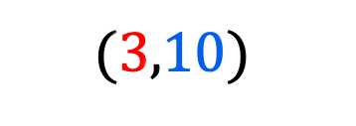



$$?$$
$$(3,10)$$
$$(2,7)$$
$$(1,4)$$
$$(0,1)$$
$$(−1,−2)$$

Slide 52


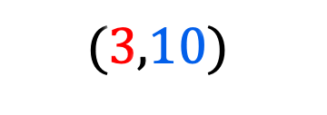


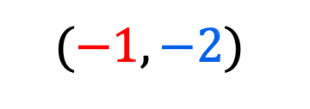
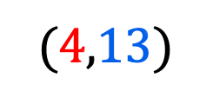
$$?$$
$$(4,13)$$
$$(3,10)$$
$$(2,7)$$
$$(1,4)$$
$$(0,1)$$
$$(−1,−2)$$

Slide 53

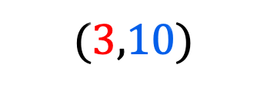


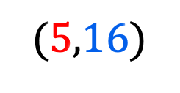

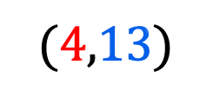
$$?$$
$$(5,16)$$
$$(4,13)$$
$$(3,10)$$
$$(2,7)$$
$$(1,4)$$
$$(0,1)$$
$$(−1,−2)$$

Slide 54


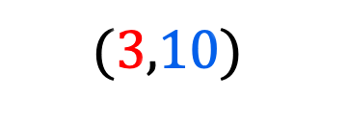


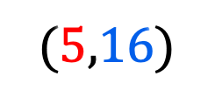

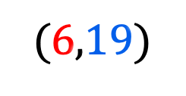
$$(6,19)$$
$$(5,16)$$
$$(4,13)$$
$$(3,10)$$
$$(2,7)$$
$$(1,4)$$
$$(0,1)$$
$$(−1,−2)$$

Slide 55








$$(6,19)$$
$$(5,16)$$
$$(4,13)$$
$$(3,10)$$
$$(2,7)$$
$$(1,4)$$
3 up
$$(0,1)$$
1 across
$$(−1,−2)$$

Slide 56

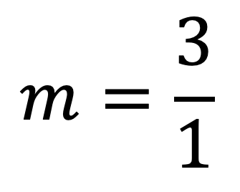
$$(6,19)$$
$$(5,16)$$
$$(4,13)$$
$$(4,13)$$
$$(3,10)$$
3 up
$$(2,7)$$
1 across
$$m=\frac{3}{1}$$
$$=3$$
3 up
$$(1,4)$$
1 across
3 up
$$(0,1)$$
1 across
$$(−1,−2)$$

Slide 57
$$(6,19)$$
$$(5,16)$$
$$(4,13)$$
$$(3,10)$$
$$(2,7)$$
9 up
$$(1,4)$$
$$(0,1)$$
3 across
$$(−1,−2)$$

Slide 58
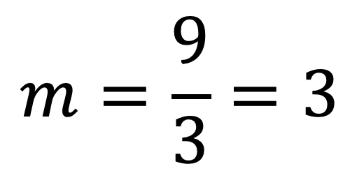
$$(6,19)$$
$$(5,16)$$
$$(4,13)$$
$$(3,10)$$
$$(2,7)$$
$$m=\frac{9}{3}=3$$
9 up
$$(1,4)$$
$$(0,1)$$
3 across
$$(−1,−2)$$

Slide 59

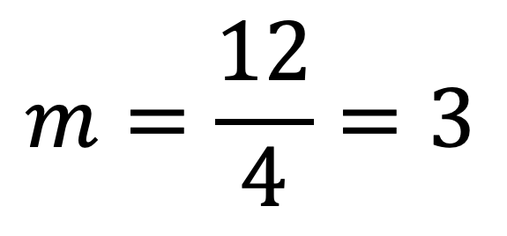

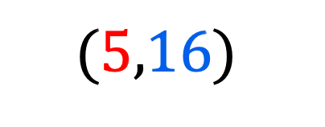

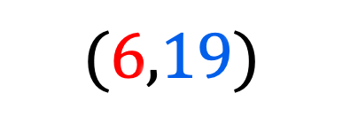

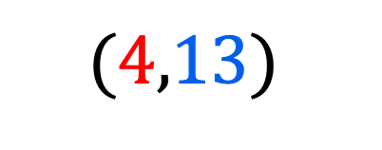

$$(6,19)$$
$$(5,16)$$
$$(4,13)$$
$$(3,10)$$
$$m=\frac{12}{4}=3$$
$$(2,7)$$
12 up
$$(1,4)$$
$$(0,1)$$
4 across
$$(−1,−2)$$

Slide 60

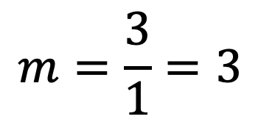


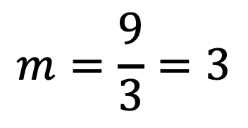


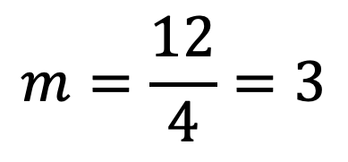


$$(4,13)$$
$$(3,10)$$
$$m=\frac{3}{1}=3$$
$$m=\frac{12}{4}=3$$
$$m=\frac{9}{3}=3$$
9 up
12 up
$$(1,4)$$
3 up
$$(0,1)$$
$$(0,1)$$
$$(0,1)$$
1 across
3 across
4 across
$$(−1,−2)$$

Slide 61
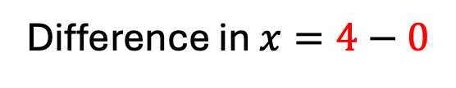
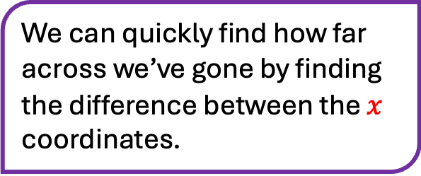
$$(6,19)$$
$$(5,16)$$
$$(4,13)$$
We can quickly find how far across we’ve gone by finding the difference between the $x$ coordinates.
Difference in $x=4−0$
12 up
$$(0,1)$$
4 across
$$(−1,−2)$$

Slide 62

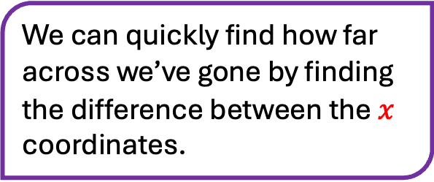
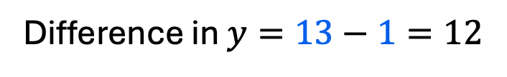
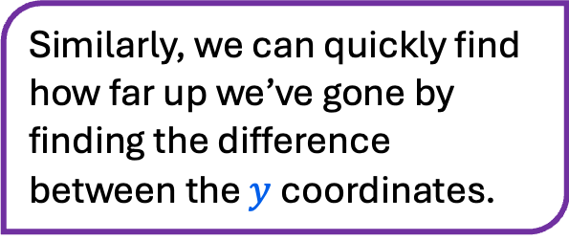


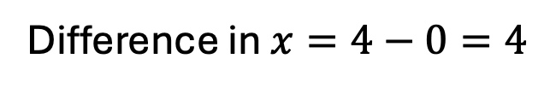
$$(6,19)$$
$$(5,16)$$
We can quickly find how far across we’ve gone by finding the difference between the $x$ coordinates.
$$(4,13)$$
$$13$$
Similarly, we can quickly find how far up we’ve gone by finding the difference between the $y$ coordinates.
Difference in $x=4−0=4$
Difference in $y=13−1=12$
12 up
$$(0,1)$$
$$1$$
4 across
$$(−1,−2)$$

Slide 63

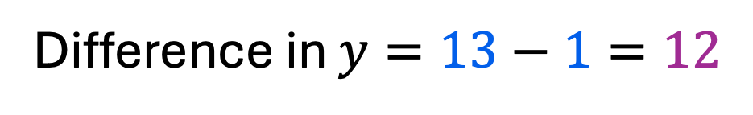
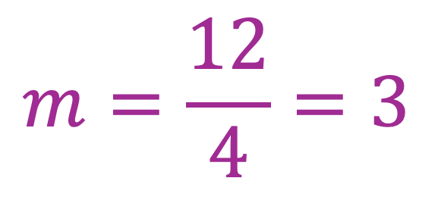
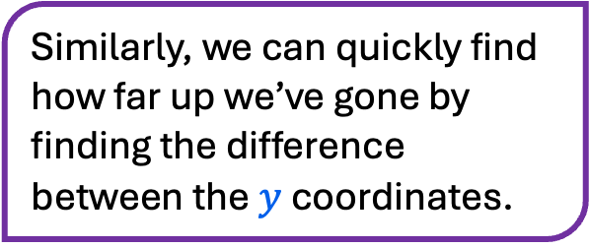
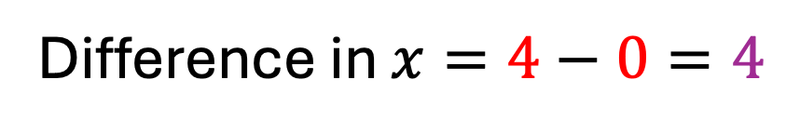
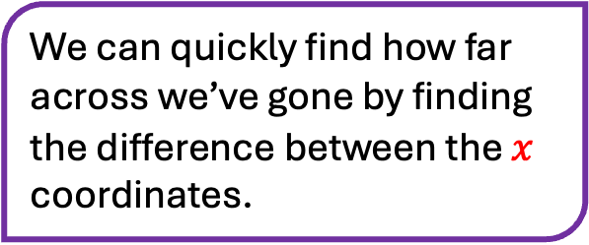
$$(6,19)$$
$$(5,16)$$
We can quickly find how far across we’ve gone by finding the difference between the $x$ coordinates.
$$(4,13)$$
Difference in $x=4−0=4$
Similarly, we can quickly find how far up we’ve gone by finding the difference between the $y$ coordinates.
$$m=\frac{12}{4}=3$$
12 up
Difference in $y=13−1=12$
$$(0,1)$$
4 across
$$(−1,−2)$$

Slide 64


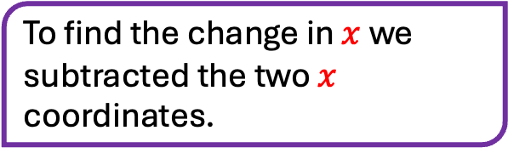

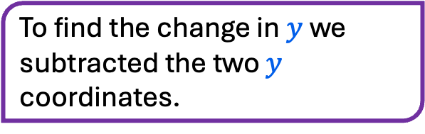

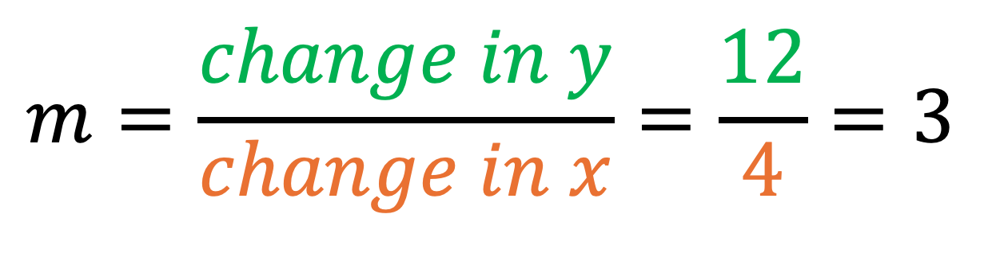
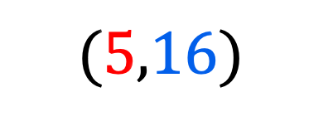
$$(6,19)$$
$$(5,16)$$
$$(4,13)$$
To find the change in $y$we subtracted the two $y$ coordinates.
$$m=\frac{change in y}{change in x}=\frac{12}{4}=3$$
12 up
To find the change in $x$we subtracted the two $x$ coordinates.
$$(0,1)$$
4 across
$$(−1,−2)$$

Slide 65



What is the gradient of this line?
$$m=\frac{change in y}{change in x}$$
$$6$$
$$2$$

Slide 66


$$3$$
What is the gradient of this line?
$$m=\frac{change in y}{change in x}$$
$$−18$$

Slide 67



$$5$$
What is the gradient of this line?
$$m=\frac{change in y}{change in x}=\frac{−5}{5}$$
$$5$$

Slide 68

Turn to page 9 in your booklet and complete question 3 on the top of this page.
Do not do question 4 yet.

Slide 69
3
4
-2

Slide 70





What is the gradient between these two coordinates?
$$m=\frac{change in y}{change in x}$$
$$(4,27)$$
$$Change in y=$$
$$Change in x=$$
$$(7,12)$$

Slide 71

What is the gradient between these two coordinates?
$$m=\frac{change in y}{change in x}$$
$$(4,27)$$
$$Change in y=$$
$$Change in x=$$
To find the change in coordinates, we’ll subtract the matching coordinates.
$$(7,12)$$

Slide 72
What is the gradient between these two coordinates?
$$m=\frac{change in y}{change in x}$$
$$(4,27)$$
$$Change in y=$$
$$Change in x=$$
Attention 🚨
You should always subtract from right to left.
To find the change in coordinates, we’ll subtract the matching coordinates.
$$(7,12)$$

Slide 73


What is the gradient between these two coordinates?
$$m=\frac{change in y}{change in x}$$
$$27$$
$$(4,27)$$
$$Change in y=$$
$$Change in x=$$
$$(7,12)$$
$$12$$
Attention 🚨
You should always subtract from right to left.
To find the change in coordinates, we’ll subtract the matching coordinates.
Notes:
Full teacher-led worked example.

Slide 74



Below are some statements.
Which ones are true and which ones are false?
Let’s reflect on what we just did…
It’s always important to subtract from right to left.
True
False
2. The equation for gradient is $m=\frac{change in x}{change in y}$.
True
False
3. The sign of the gradient doesn’t really matter, an answer of $m=5$ or $m=−5$ would both be good enough.
True
False
Notes:
Voting using fingers.

Slide 75







Consider the coordinates $(−2,6)$ and $\left(3,21\right).$
Which sketch is the most accurate?
$$(3,21)$$
$$(3,21)$$
$$(−2,6)$$
$$(3,21)$$
$$(−2,6)$$
$$(−2,6)$$
A
B
C

Slide 76



Let’s find the gradient between two points again.
This time you can help.
What is the gradient between $(−2,6)$ and $(3,21)$.
$$(3,21)$$
$$(−2,6)$$

Slide 77






Let’s find the gradient between two points again.
This time you can help.
What is the gradient between $(−2,6)$ and $(3,21)$.
What is the equation for the gradient?
$$m=\frac{change in x}{change in y}$$
$$m=\frac{y}{x}$$
$$m=\frac{change in x}{change in x}$$
$$m=\frac{change in y}{change in x}$$
$$(3,21)$$
$$m=\frac{x}{y}$$
$$m=\frac{change in y}{change in y}$$
$$(−2,6)$$

Slide 78

Let’s find the gradient between two points again.
This time you can help.
What is the gradient between $(−2,6)$ and $(3,21)$.
What is the equation for the gradient?
$$m=\frac{change in y}{change in x}$$
What is the change in y?
$$(3,21)$$
$$(−2,6)$$

Slide 79

Let’s find the gradient between two points again.
This time you can help.
What is the gradient between $(−2,6)$ and $(3,21)$.
What is the equation for the gradient?
$$m=\frac{change in y}{change in x}$$
What is the change in y?
$$(3,21)$$
$$change in y=15$$
What is the change in x?
$$(−2,6)$$

Slide 80

Let’s find the gradient between two points again.
This time you can help.
What is the gradient between $(−2,6)$ and $(3,21)$.
What is the equation for the gradient?
$$m=\frac{change in y}{change in x}$$
What is the change in y?
$$(3,21)$$
$$change in y=15$$
What is the change in x?
$$change in x=5$$
$$(−2,6)$$
What is the gradient?

Slide 81







Let’s find the gradient between two points again.
This time you can help.
What is the gradient between $(−1,10)$ and $(2,−2)$.
Which sketch is the most accurate?
$$(−1,10)$$
$$(−1,10)$$
$$(2,−2)$$
$$(2,−2)$$
$$(−1,10)$$
$$(2,−2)$$
A
B
C

Slide 82









What is the equation for the gradient?
$$m=\frac{change in x}{change in y}$$
$$m=\frac{y}{x}$$
$$(−1,10)$$
$$m=\frac{change in x}{change in x}$$
$$m=\frac{x}{y}$$
$$m=\frac{change in y}{change in x}$$
$$m=\frac{change in y}{change in y}$$
$$(2,−2)$$

Slide 83





$$m=\frac{change in y}{change in x}$$
$$(−1,10)$$
$$change in y=$$
$$change in x=$$
$$(2,−2)$$

Slide 84


$$m=\frac{change in y}{change in x}$$
$$(−1,10)$$
$$change in y=−12$$
$$change in x=3$$
Calculate the gradient:
$$(2,−2)$$

Slide 85


$$m=\frac{change in y}{change in x}$$
$$m=\frac{}{}$$

Slide 86

$$m=\frac{change in y}{change in x}$$
$$m=\frac{y_{2}−y_{1}}{x_{2}−x_{1}}$$
This is an important equation for the gradient.

Slide 87





$$m=\frac{y_{2}−y_{1}}{x_{2}−x_{1}}$$
$$(−1,20)$$
$$(x_{1},y_{1})$$
$$(3,4)$$
$$(x_{2},y_{2})$$
Notes:
Full worked example.

Slide 88



$$m=\frac{y_{2}−y_{1}}{x_{2}−x_{1}}$$
$$(3,9)$$
$$(1,−3)$$

Slide 89

Turn to page 9 in your booklet and complete question 4 on the top of this page.

Slide 90









$$m=\frac{9−−1}{4−2}$$
$$m=\frac{10}{2}$$
$$m=5$$
$$m=\frac{2−8}{4−1}$$
$$m=\frac{5−9}{1−0}$$
$$m=\frac{−6}{3}$$
$$m=\frac{−4}{1}$$
$$m=−2$$
$$m=−4$$

Slide 91


Imagine we had a line passing through $(3,2)$.
The line has a gradient of 2.
Can you find any other coordinates it will go through?
Click on the other coordinates it will pass through.
8
7
6
5
4
3
2
1
0
-1
-2
-3
$$(3,2)$$
-4 | -3 | -2 | -1 | 0 | 1 | 2 | 3 | 4 | 5 | 6 | 7 | 8
Notes:
Upto teacher how to collect whole class formative assessment on this one.
Suggestion: Use finger to scan different grid points. If you point to the correct coordinate students should thumb up or thumb down.

Slide 92


Imagine we had a line passing through $(−1,3)$.
The line has a gradient of $−1$.
Can you find any other coordinates it will go through?
Click on the other coordinates it will pass through.
8
7
6
5
4
3
2
1
0
-1
-2
-3
$$(−1,3)$$
-4 | -3 | -2 | -1 | 0 | 1 | 2 | 3 | 4 | 5 | 6 | 7 | 8
Notes:
Upto teacher how to collect whole class formative assessment on this one.
Suggestion: Use finger to scan different grid points. If you point to the correct coordinate students should thumb up or thumb down.

Slide 93

One last thing!
8
7
6
5
4
3
2
1
0
-1
-2
-3
Look at this line. It’s gradient is interesting.
Write down on the MWB what you think the gradient of this line is.
$$m= ?$$
-4 | -3 | -2 | -1 | 0 | 1 | 2 | 3 | 4 | 5 | 6 | 7 | 8

Slide 94

$$m= ?$$
8
7
6
5
4
3
2
1
0
-1
-2
-3
-4 | -3 | -2 | -1 | 0 | 1 | 2 | 3 | 4 | 5 | 6 | 7 | 8

Slide 95

$$m=$$

Slide 96

$$m=\frac{}{}$$

Slide 97

You may now work on the sudoku puzzles until the end of the lesson.
Please do not begin lesson 3.

