Slide 1

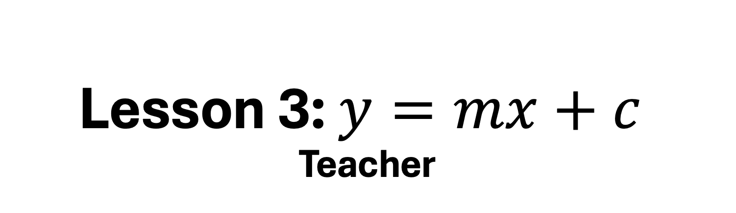
Lesson 3: $y=mx+c$
Teacher
25 – 30 minutes

Slide 2
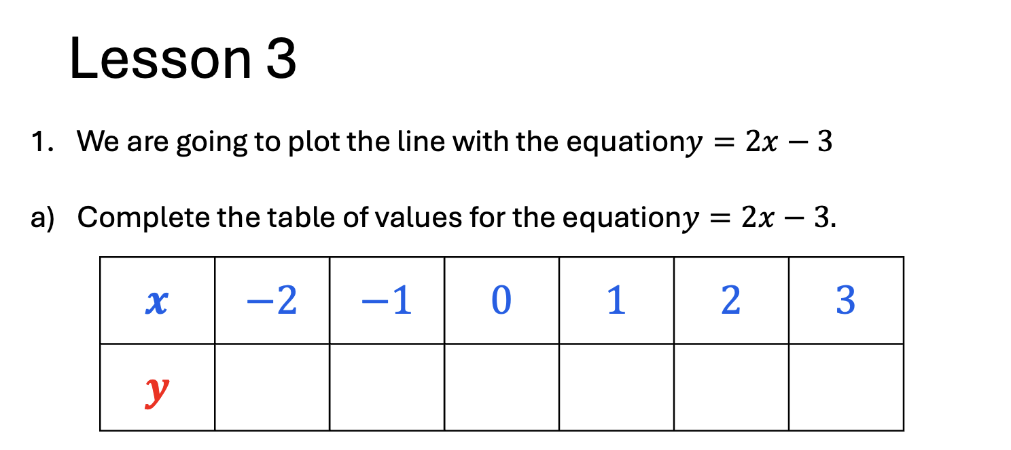
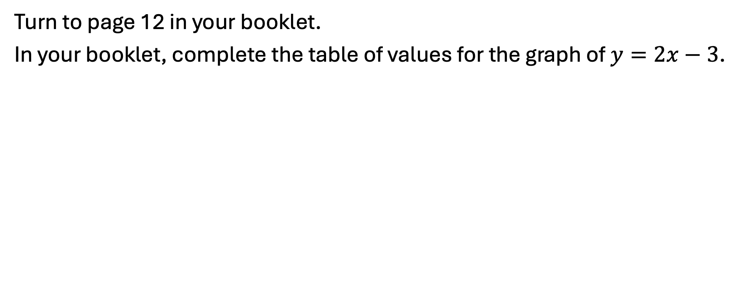
Let’s begin…
Turn to page 12 in your booklet.
In your booklet, complete the table of values for the graph of $y=2x−3$.

Slide 3
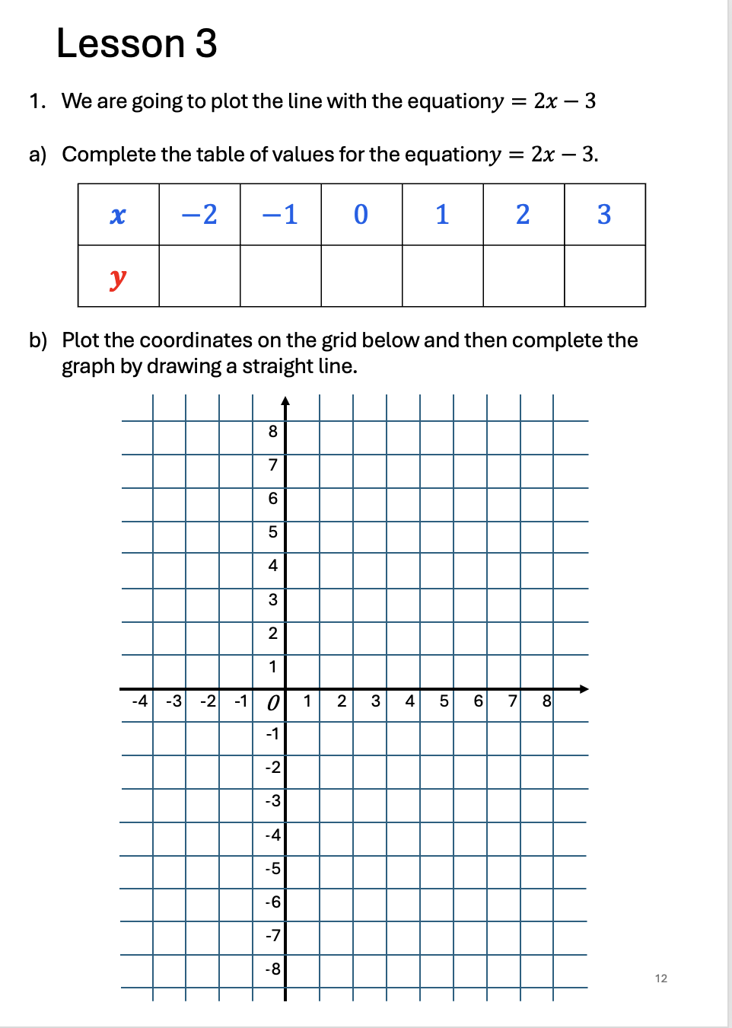
Now plot the coordinates and then draw a straight-line graph.
Remember to use your ruler!

Slide 4
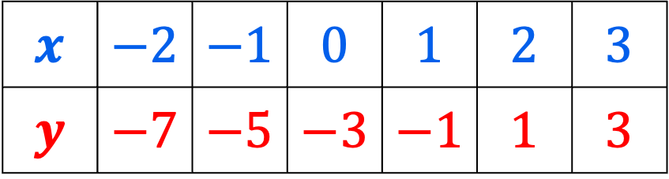
$$x$$ | $$−2$$ | $$−1$$ | $$0$$ | $$1$$ | $$2$$ | $$3$$
$$y$$ | $$−7$$ | $$−5$$ | $$−3$$ | $$−1$$ | $$1$$ | $$3$$
8
7
6
5
4
3
2
1
0
-1
-2
-3
-4 | -3 | -2 | -1 | 0 | 1 | 2 | 3 | 4 | 5 | 6 | 7 | 8

Slide 5
What is the gradient of this line?

Slide 6
What is the gradient of this line?

Slide 7
What is the gradient of this line?

Slide 8
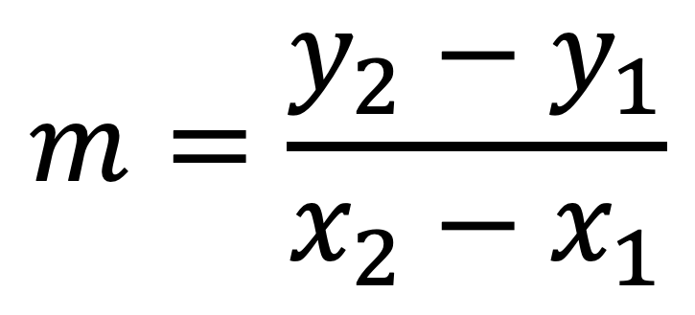


What is the gradient of this line?
$$(5,12)$$
$$m=\frac{y_{2}−y_{1}}{x_{2}−x_{1}}$$
$$(2,−3)$$
Notes:
Recap finding the gradient from the equation, students to complete on miniwhiteboards.

Slide 9
Lesson 1
Lesson 2
We learned:
How to calculate a table of values for an equation.
How to plot these values to create a straight-line graph.
We learned:
That the gradient is a measure of how steep a line is.
How to find the gradient of a line.
How to find the gradient between 2 points.

Slide 10
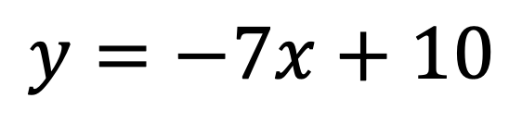
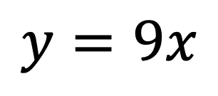
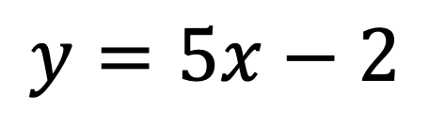
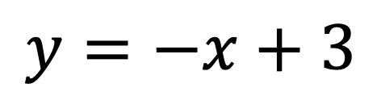
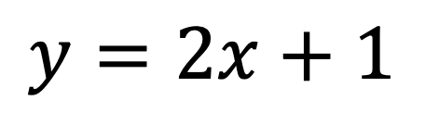
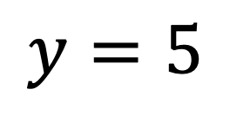
Here are some equations of straight-line graphs.
$$y=5x−2$$
$$y=−7x+10$$
$$y=−x+3$$
$$y=2x+1$$
$$y=9x$$
$$y=5$$

Slide 11

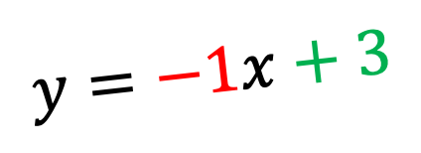
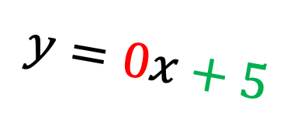
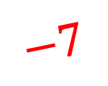

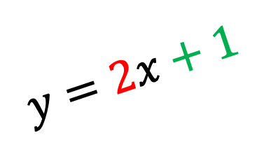
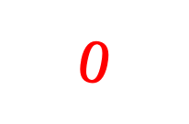
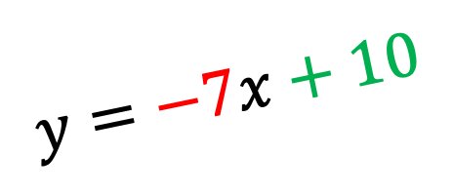
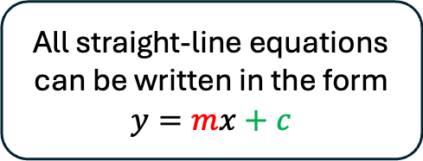
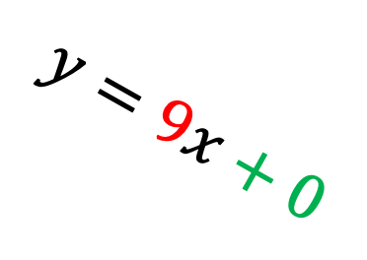
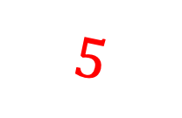
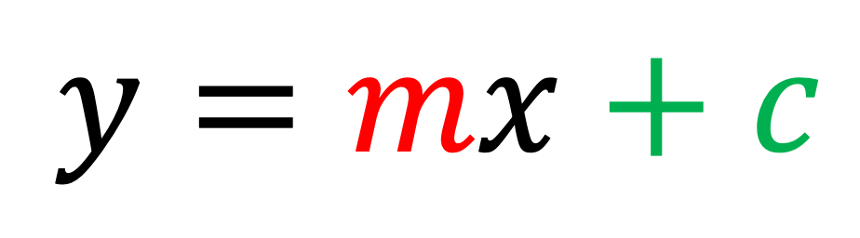
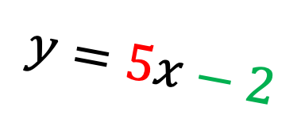
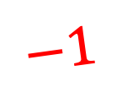
Here are some equations of straight-line graphs.
$$y=−1x+3$$
$$0$$
$$−1$$
$$y=0x+5$$
$$5$$
$$y=−7x+10$$
$$y=5x−2$$
$$−7$$
$$y=mx+c$$
$$9$$
$$y=9x+0$$
$$y=2x+1$$
$$2$$
All straight-line equations can be written in the form
$$y=mx+c$$
Let’s look at some examples…

Slide 12
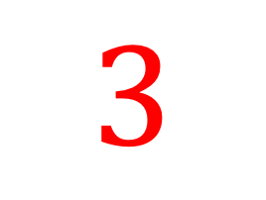
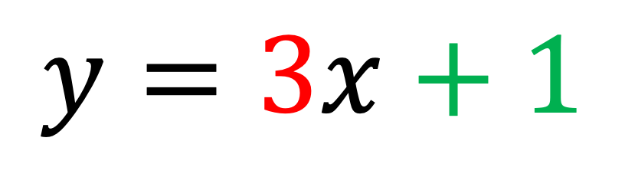

10
$$y=mx+c$$
5
$$y=3x+1$$
$$3$$
-5
0
5
10
-5

Slide 13
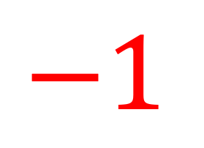
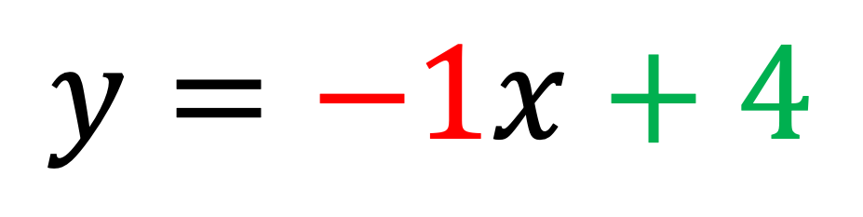
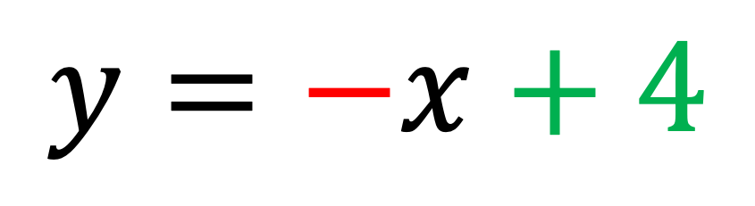

10
$$y=mx+c$$
5
$$y=−x+4$$
$$−$$
-5
0
5
10
$$−1$$
$$y=−1x+4$$
-5

Slide 14
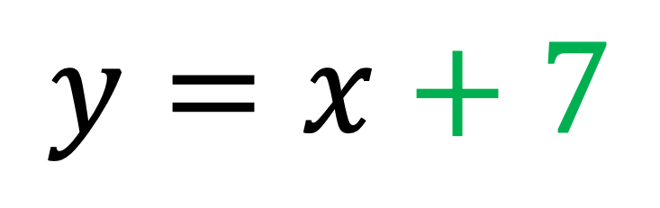
10
$$y=mx+c$$
5
$$y=x+7$$
-5
0
5
10
-5

Slide 15
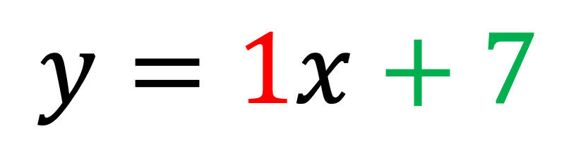

10
$$y=mx+c$$
5
$$y=1x+7$$
$$1$$
-5
0
5
10
-5

Slide 16
10
$$y=mx+c$$
5
$$y=x+7$$
-5
0
5
10
-5

Slide 17
10
$$y=mx+c$$
5
$$y=1x+7$$
$$1$$
-5
0
5
10
-5

Slide 18
10
$$y=mx+c$$
5
$$y=x+7$$
-5
0
5
10
-5

Slide 19
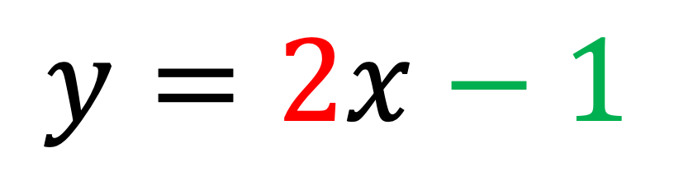
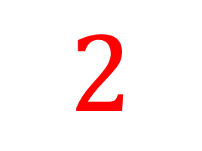
10
$$y=mx+c$$
5
$$y=2x−1$$
$$2$$
-5
0
5
10
-5

Slide 20
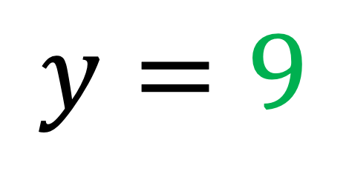
10
$$y=mx+c$$
5
$$y=9$$
-5
0
5
10
-5

Slide 21
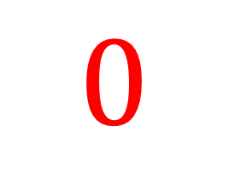
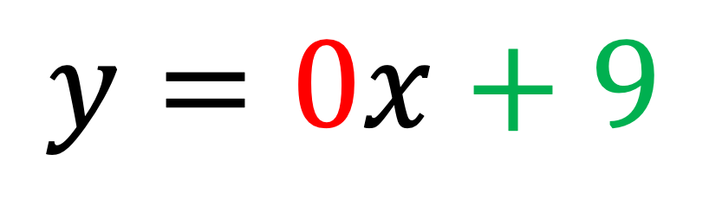
10
$$y=mx+c$$
5
$$y=0x+9$$
$$0$$
-5
0
5
10
-5

Slide 22
10
$$y=mx+c$$
5
$$y=9$$
-5
0
5
10
-5

Slide 23
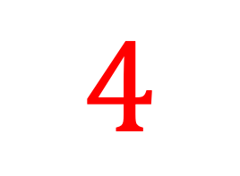
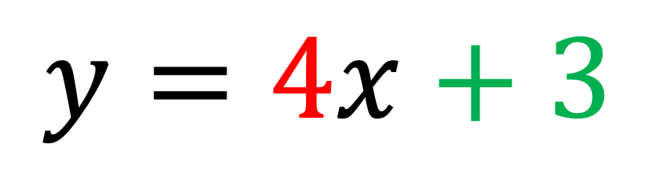
10
$$y=mx+c$$
5
$$y=4x+3$$
$$4$$
-5
0
5
10
-5

Slide 24

Straight Line Equations
Not

Slide 25
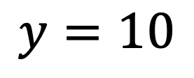
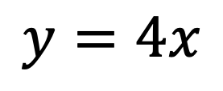
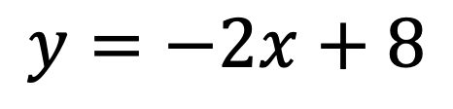
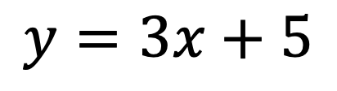
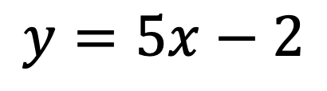
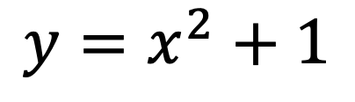
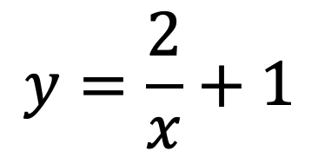

We have seen what straight line graph equations look like.
$$5=3x+1$$
$$y=3x+5$$
$$y=\frac{2}{x}+1$$
$$y=5x−2$$
$$y=4x$$
$$y=x^{2}+1$$
$$y=10$$
$$y=−2x+8$$

Slide 26
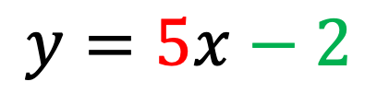
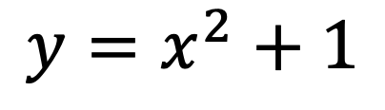
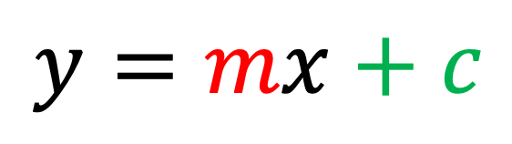
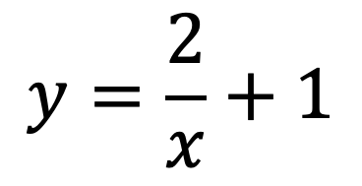

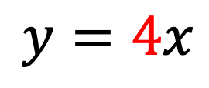



$$y=mx+c$$
$$y=3x+5$$
$$y=\frac{2}{x}+1$$
$$y=4x$$
$$5=3x+1$$
$$y=−2x+8$$
$$y=x^{2}+1$$
$$y=10$$
$$y=5x−2$$

Slide 27

$$y=mx+c$$

Slide 28






$$m$$
$$y= x+c$$
Gradient
The value of $m$ tells you the gradient.
$$y=3x+5$$
$$y=−4x$$
$$y=5x−2$$

Slide 29



y-axis
y-intercept
The value of $c$ tells you the y-intercept.
y-intercept means where the line crosses the y-axis.
$$+c$$
$y=mx$

Slide 30
$$y=mx+c$$

Slide 31

Here is a graph.
The $y−$intercept is where the line crosses the y-axis.
Where is the $y−$intercept on this graph?
10
5
-5
0
5
10
-5
Notes:
Scan the straight line with your finger.
Students should raise their thumb the moment you are touching the y-intercept.

Slide 32



$$y=3x+8$$
$$3$$
10
What is the $y−$intercept of this equation?
5
-5
0
5
10
-5

Slide 33

$$y=3x+8$$
$$3$$
10
The y-intercept is 8.
Which coordinate will be the y-intercept on the grid?
5
-5
0
5
10
-5
Notes:
Point to the grid in various coordinates.
Students should raise their thumb when you are pointing to the correct coordinate.

Slide 34

$$y=3x+8$$
$$3$$
10
$$(0,8)$$
What is the gradient of this equation?
5
-5
0
5
10
-5

Slide 35

$$y=3x+8$$
$$3$$
10
Now, we need a line with a gradient of 3.
Which of the diagrams below are a gradient of 3?
$$(0,8)$$
5
A
B
C
0
5
10
D
E
F
-5

Slide 36


$$y=3x+8$$
$$3$$
10
Yes, the line looks like this.
It has a gradient of 3.
The y-intercept is 8, so it goes through coordinate $\left(0,8\right).$
$$(0,8)$$
5
-5
0
5
10
-5

Slide 37


$$y=x−3$$
$$y=x−3$$
10
What is the $y−$intercept of this equation?
5
-5
0
5
10
-5

Slide 38


$$y=x−3$$
10
Yes!
The line will pass through $\left(0,−3\right)$
Find this coordinate on the grid and click there to plot the coordinate.
5
-5
0
5
10
$$(0,−3)$$
-5

Slide 39
$$y=x−3$$
10
Now we need to figure out the gradient of this line.
What do you think the gradient is?
5
-5
0
5
10
$$(0,−3)$$
-5

Slide 40



$$y=1x−3$$
$$1$$
10
Yes! The gradient is $m=1$.
Which of the diagrams below are a gradient of 1?
5
A
B
C
0
5
10
D
E
F
$$(0,−3)$$
-5

Slide 41


$$y=−2x$$
$$−2$$
10
What is the $y−$intercept of this equation?
5
-5
0
5
10
-5

Slide 42


$$y=−2x$$
$$−2$$
10
Yes!
The line will pass through $\left(0,0\right)$
5
-5
0
5
10
-5
Notes:
Where is this coordinate?

Slide 43

$$y=−2x$$
$$−2$$
10
Now we need to figure out the gradient of this line.
What do you think the gradient is?
5
-5
0
5
10
$$(0,0)$$
-5

Slide 44


$$y=−2x$$
$$−2$$
10
Yes! The gradient is $m=−2$.
Which of the diagrams below are a gradient of $−2$?
5
-5
0
5
10
$$(0,0)$$
-5

Slide 45



$$y=−2x$$
$$−2$$
10
Yes, the line looks like this.
It has a gradient of -2.
The y-intercept is 0, so it goes through coordinate $\left(0,0\right).$
5
-5
0
5
10
$$(0,0)$$
-5

Slide 46


$$y=2x+1$$
$$2$$
Which of the below graphs show the line with the equation $y=2x+1$?
10
10
10
10
5
5
5
5
0
5
10
0
5
10
0
5
10
0
5
10
-5
-5
-5
-5
A
B
C
D

Slide 47
$$y=2x+1$$
$$2$$
Which of the below graphs show the line with the equation $y=2x+1$?
10
5
Yes, the y-intercept is (0,1).
0
5
10
And the gradient is 2!
-5

Slide 48


$$y=−3x+5$$
$$−3$$
Which of the below graphs show the line with the equation $y=−3x+5$?
10
10
10
10
5
5
5
5
0
5
10
0
5
10
0
5
10
0
5
10
-5
-5
-5
-5
A
B
C
D

Slide 49


$$y=−3x+5$$
$$−3$$
Which of the below graphs show the line with the equation $y=−3x+5$?
10
Yes, the y-intercept is (0,5).
5
And the gradient is -3!
0
5
10
-5

Slide 50

Turn to page 13 in your booklet and complete the questions on this page.
You must complete all questions and check your answers before continuing.

Slide 52

Turn to page 14 in your booklet and complete the questions on this page.
You must complete all questions and check your answers before continuing.

Slide 54

Turn to page 15 in your booklet and complete the questions on this page.
You must complete all questions and check your answers before continuing.

Slide 56


8
7
6
5
4
3
2
1
0
-1
-2
-3
$$y= x+3$$
$$5$$
-4 | -3 | -2 | -1 | 0 | 1 | 2 | 3 | 4 | 5 | 6 | 7 | 8

Slide 57


8
7
6
5
4
3
2
1
0
-1
-2
-3
$$y= x+3$$
$$4$$
-4 | -3 | -2 | -1 | 0 | 1 | 2 | 3 | 4 | 5 | 6 | 7 | 8

Slide 58


8
7
6
5
4
3
2
1
0
-1
-2
-3
$$y= x+3$$
$$3$$
-4 | -3 | -2 | -1 | 0 | 1 | 2 | 3 | 4 | 5 | 6 | 7 | 8

Slide 59


8
7
6
5
4
3
2
1
0
-1
-2
-3
$$y= x+3$$
$$2$$
-4 | -3 | -2 | -1 | 0 | 1 | 2 | 3 | 4 | 5 | 6 | 7 | 8

Slide 60

8
7
6
5
4
3
2
1
0
-1
-2
-3
$$y= x+3$$
$$1$$
-4 | -3 | -2 | -1 | 0 | 1 | 2 | 3 | 4 | 5 | 6 | 7 | 8

Slide 61


8
7
6
5
4
3
2
1
0
-1
-2
-3
$$y= x+3$$
$$0$$
-4 | -3 | -2 | -1 | 0 | 1 | 2 | 3 | 4 | 5 | 6 | 7 | 8

Slide 62


8
7
6
5
4
3
2
1
0
-1
-2
-3
$$y= x+3$$
$$−1$$
-4 | -3 | -2 | -1 | 0 | 1 | 2 | 3 | 4 | 5 | 6 | 7 | 8

Slide 63

8
7
6
5
4
3
2
1
0
-1
-2
-3
$$y= x+3$$
$$−2$$
-4 | -3 | -2 | -1 | 0 | 1 | 2 | 3 | 4 | 5 | 6 | 7 | 8

Slide 64


8
7
6
5
4
3
2
1
0
-1
-2
-3
$$y= x+3$$
$$−3$$
-4 | -3 | -2 | -1 | 0 | 1 | 2 | 3 | 4 | 5 | 6 | 7 | 8

Slide 65
Now let’s investigate the y-intercept…
😊

Slide 66


8
7
6
5
4
3
2
1
0
-1
-2
-3
$$y=2x+$$
$$5$$
-4 | -3 | -2 | -1 | 0 | 1 | 2 | 3 | 4 | 5 | 6 | 7 | 8

Slide 67

8
7
6
5
4
3
2
1
0
-1
-2
-3
$$y=2x+$$
$$4$$
-4 | -3 | -2 | -1 | 0 | 1 | 2 | 3 | 4 | 5 | 6 | 7 | 8

Slide 68

8
7
6
5
4
3
2
1
0
-1
-2
-3
$$y=2x+$$
$$3$$
-4 | -3 | -2 | -1 | 0 | 1 | 2 | 3 | 4 | 5 | 6 | 7 | 8

Slide 69

8
7
6
5
4
3
2
1
0
-1
-2
-3
$$y=2x+$$
$$2$$
-4 | -3 | -2 | -1 | 0 | 1 | 2 | 3 | 4 | 5 | 6 | 7 | 8

Slide 70

8
7
6
5
4
3
2
1
0
-1
-2
-3
$$y=2x+$$
$$1$$
-4 | -3 | -2 | -1 | 0 | 1 | 2 | 3 | 4 | 5 | 6 | 7 | 8

Slide 71

8
7
6
5
4
3
2
1
0
-1
-2
-3
$$y=2x+$$
$$0$$
-4 | -3 | -2 | -1 | 0 | 1 | 2 | 3 | 4 | 5 | 6 | 7 | 8

Slide 72


8
7
6
5
4
3
2
1
0
-1
-2
-3
$$y=2x$$
$$−1$$
-4 | -3 | -2 | -1 | 0 | 1 | 2 | 3 | 4 | 5 | 6 | 7 | 8

Slide 73

8
7
6
5
4
3
2
1
0
-1
-2
-3
$$y=2x$$
$$−2$$
-4 | -3 | -2 | -1 | 0 | 1 | 2 | 3 | 4 | 5 | 6 | 7 | 8

Slide 74
What is the gradient of this line?
Positive
Flat
Negative
10
5
-5
0
5
10
-5

Slide 75

What is the gradient of this line?
Positive
Flat
Negative
10
What is the value of gradient of this line?
5
-5
0
5
10
-5

Slide 76

What is the gradient of this line?
Positive
Flat
Negative
10
What is the value of gradient of this line?
5
$$m=−1$$
What is the y-intercept?
-5
0
5
10
-5

Slide 77



$$m=−1$$
$$c=9$$
10
$$y=mx+c$$
What is the equation of the line?
5
-5
0
5
10
-5

Slide 78

10
$$y=mx+c$$
5
-5
0
5
10
-5
Notes:
What is the gradient?
What is the y-intercept?
What is the equation of the straight line?

Slide 79
10
$$y=mx+c$$
5
-5
0
5
10
-5

Slide 80


What is the gradient of this line?
$$(2,9)$$
Negative
Flat
Positive
$$(0,3)$$

Slide 81
What is the value of the gradient of this line?
$$(2,9)$$
$$(0,3)$$

Slide 82

What is the value of the gradient of this line?
What is the y-intercept of this line?
$$(2,9)$$
$$m=3$$
$$(0,3)$$

Slide 83


What is the value of the gradient of this line?
What is the y-intercept of this line?
What is the equation of the straight line?
$$(2,9)$$
$$m=3$$
$$c=3$$
$$(0,3)$$

Slide 84


$$(2,9)$$
$$3$$
$$y=3x+3$$
$$(0,3)$$

Slide 85



What is the gradient of this line?
$$(0,30)$$
$$y=mx+c$$
$$3$$
$$4$$
$$5$$
$$0$$
$$1$$
$$2$$
$$−3$$
$$−2$$
$$−1$$
$$(5,15)$$

Slide 86

$$m=−3$$
What is the y-intercept?
$$(0,30)$$
$$y=mx+c$$
$$3$$
$$4$$
$$5$$
$$0$$
$$1$$
$$2$$
$$−3$$
$$−2$$
$$−1$$
$$(5,15)$$

Slide 87

$$(0,30)$$
$$−3$$
$$y=−3x+30$$
$$(5,15)$$

Slide 88




Match the graph to the equation.
$$y=5$$
$$y=x+4$$
$$y=−2x+6$$
$$y=2x−1$$
8
7
6
5
4
3
2
1
0
-1
-2
-3
8
7
6
5
4
3
2
1
0
-1
-2
-3
8
7
6
5
4
3
2
1
0
-1
-2
-3
8
7
6
5
4
3
2
1
0
-1
-2
-3
-4 | -3 | -2 | -1 | 0 | 1 | 2 | 3 | 4 | 5 | 6 | 7 | 8
-4 | -3 | -2 | -1 | 0 | 1 | 2 | 3 | 4 | 5 | 6 | 7 | 8
-4 | -3 | -2 | -1 | 0 | 1 | 2 | 3 | 4 | 5 | 6 | 7 | 8
-4 | -3 | -2 | -1 | 0 | 1 | 2 | 3 | 4 | 5 | 6 | 7 | 8
A
B
C
D

Slide 89

Lesson 1:
We learned how to plot a straight-line graph using a table of values.
Lesson 2:
We learned about gradients and how to find the value of a gradient.
Lesson 3:
Today we learned that straight-lines have the equation $y=mx+c.$

Slide 90









$$y=3x+1$$
$$x$$ | $$−2$$ | $$−1$$ | $$0$$ | $$1$$ | $$2$$ | $$3$$
$$y$$ | $$−5$$ | $$−2$$ | $$1$$ | $$4$$ | $$7$$ | $$10$$
Lesson 1:
We learned how to plot a straight-line graph using a table of values.
Lesson 2:
We learned about gradients and how to find the value of a gradient.
Lesson 3:
Today we learned that straight-lines have the equation $y=mx+c.$
10
$$(3,10)$$
$$(2,7)$$
5
$$(1,3)$$
$$(0,1)$$
-5
0
5
10
$$(−1,−2)$$
-5
$$(−2,−5)$$

Slide 91






$$m=\frac{change in y}{change in x}$$
Lesson 2:
We learned about gradients and how to find the value of a gradient.
Lesson 1:
We learned how to plot a straight-line graph using a table of values.
Lesson 3:
Today we learned that straight-lines have the equation $y=mx+c.$
$$m=\frac{2−8}{2−−1}=\frac{−6}{3}=−2$$
$$(−1,8)$$
$$m=−2$$
$$(2,2)$$

Slide 92




y-intercept
The value of $c$ tells you the y-intercept.
Lesson 3:
Today we learned that straight-lines have the equation $y=mx+c.$
Lesson 1:
We learned how to plot a straight-line graph using a table of values.
Lesson 2:
We learned about gradients and how to find the value of a gradient.
$$y=mx+c$$
Gradient
The value of $m$ tells you the gradient.

Slide 93


You can now work through the sudokus on page 16 while you wait for everyone else to finish.

