Slide 1
Lesson 4: Problem-Solving
Teacher

Slide 2
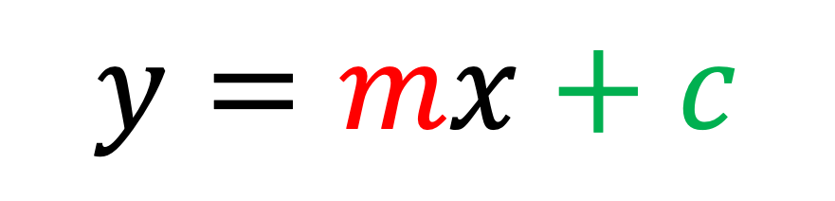
What is the gradient of this line?
10
$$y=mx+c$$
5
-5
0
5
10
-5

Slide 3

What is the gradient of this line?
10
5
-5
0
5
10
-5

Slide 4
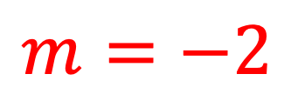
What is the gradient of this line?
$$m=−2$$
10
What is the y-intercept of this line?
5
-5
0
5
10
-5

Slide 5
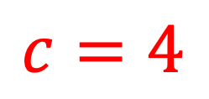
What is the gradient of this line?
$$m=−2$$
10
What is the y-intercept of this line?
5
$$c=4$$
What is the equation of this straight line?
-5
0
5
10
-5

Slide 6
$$y=mx+c$$
10
What is the equation of this straight line?
5
0
5
10
-5

Slide 7
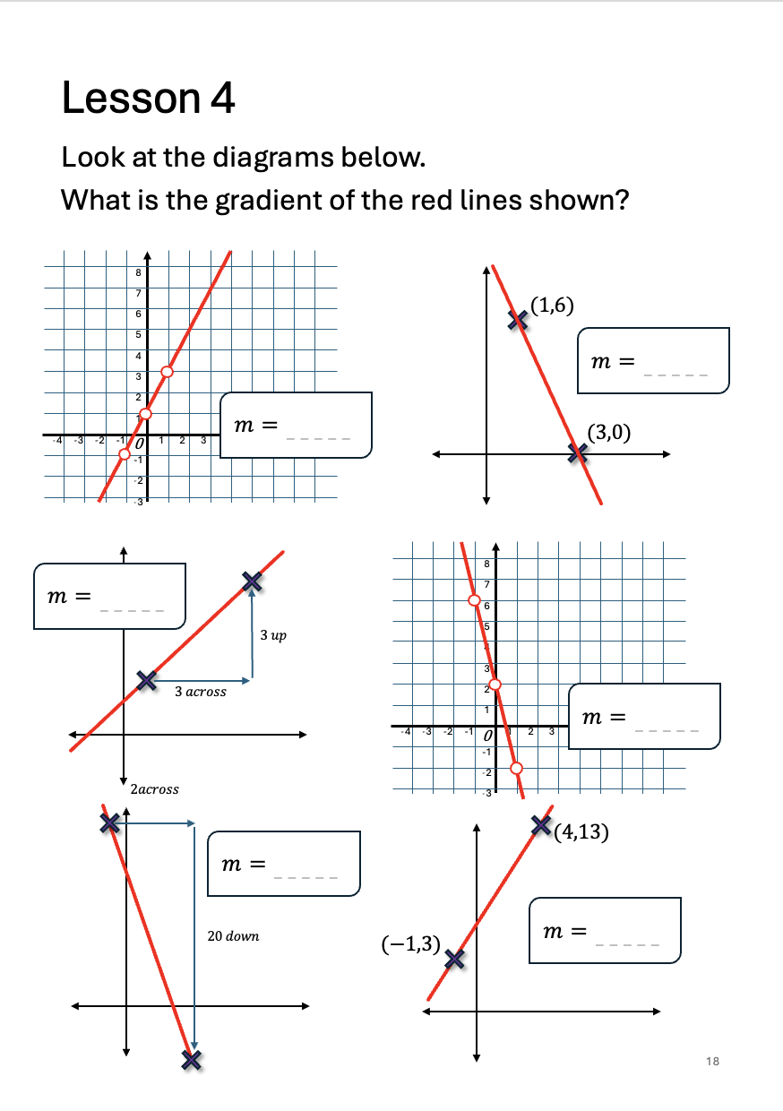
Turn to page 18 in your booklet and complete the questions on this page.
You must complete all questions and check your answers before continuing.

Slide 8






$$−3$$
$$2$$
$$1$$
$$−4$$
$$−10$$
$$2$$

Slide 9
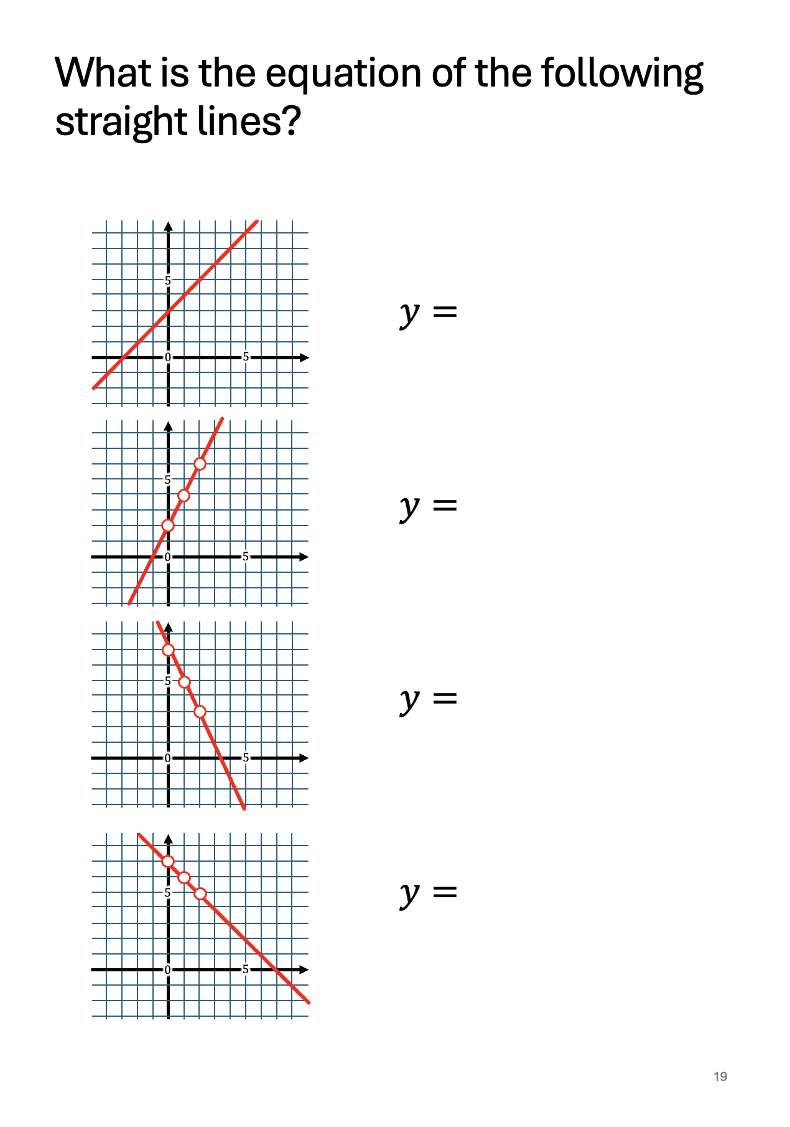
Now turn to page 19 in your booklet and complete the questions on this page.
You must complete all questions and check your answers before continuing.

Slide 10




$$x+3$$
$$2x+2$$
$$−2x+7$$
$$−x+7$$

Slide 11
Parallel Lines
Parallel lines are lines which never cross.
They stay equal distance from each other, forever going in the same direction.

Slide 12
Parallel Lines
Parallel lines are lines which never cross.
They stay equal distance from each, forever going in the same direction.
Parallel
Not Parallel

Slide 13
Not Parallel
Parallel

Slide 14
Parallel Lines
Parallel lines are lines which never cross.
They stay equal distance from each, forever going in the same direction.
Parallel
Not Parallel

Slide 15
Parallel Lines
Parallel lines are lines which never cross.
They stay equal distance from each, forever going in the same direction.
Parallel
Not Parallel

Slide 16
Parallel Lines
Parallel lines are lines which never cross.
They stay equal distance from each, forever going in the same direction.
Parallel
Not Parallel

Slide 17
Parallel Lines
Parallel lines are lines which never cross.
They stay equal distance from each, forever going in the same direction.
Parallel
Not Parallel

Slide 18
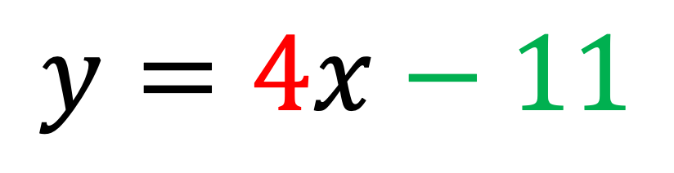
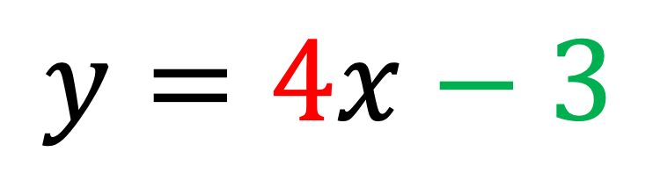

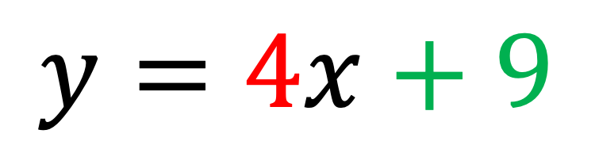


$$4$$
$$y=4x+9$$
10
$$4$$
$$y=4x−3$$
5
-5
0
5
10
$$y=4x−11$$
$$4$$
-5
These 3 lines are all parallel because they have the same gradient.

Slide 19
A) the same
Parallel lines have gradient.
B) different
C) the opposite

Slide 20
Parallel lines have the same gradient.
different
the opposite

Slide 21
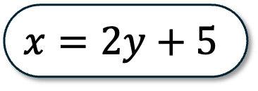
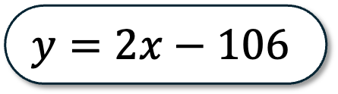
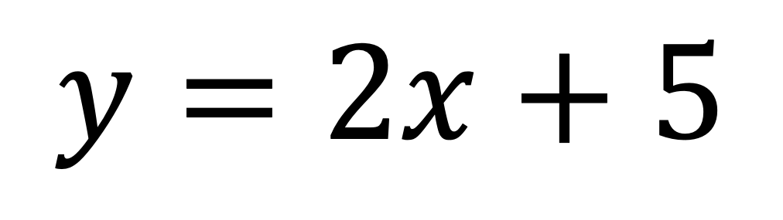
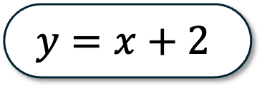
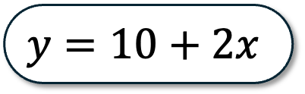

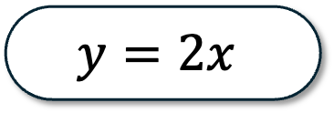
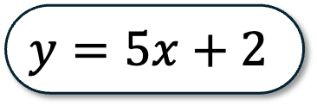
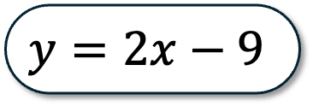
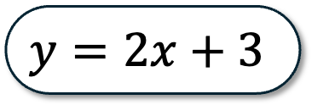
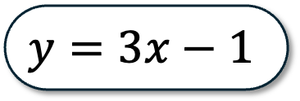
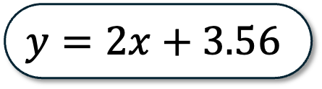
Which equations are parallel to $y=2x+5$ ?
$$y=3x−1$$
$$y=2x+3$$
$$y=10+2x$$
$$y=5x+2$$
$$y=2x+5$$
$$y=2x−106$$
$$y=2x$$
$$x=2y+5$$
$$y=5$$
$$y=2x+3.56$$
$$y=x+2$$
$$y=2x−9$$
Notes:
Whole class AFL: teacher prerogative how to manage this.
Suggestion: point to individual equations and get them to thumbs up for parallel, thumbs down for not parallel?

Slide 22
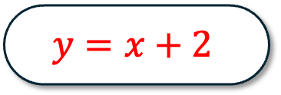
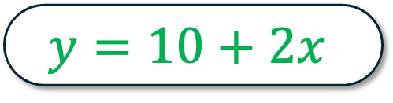


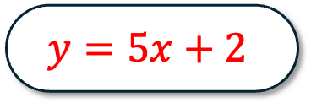
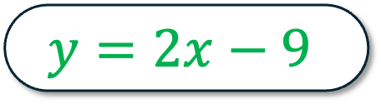
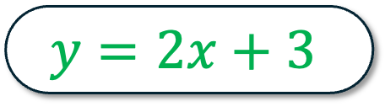
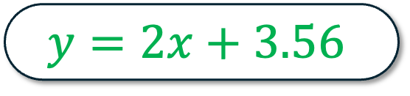
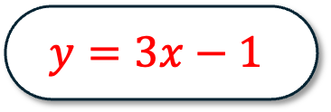
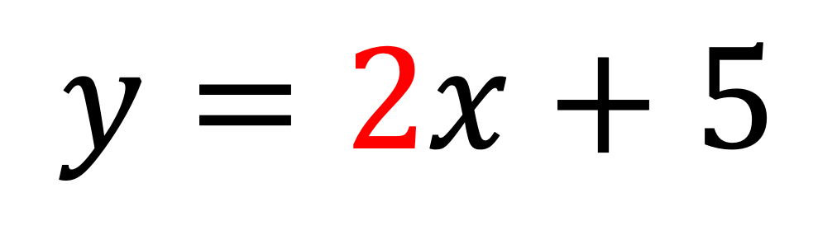
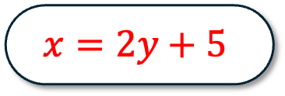
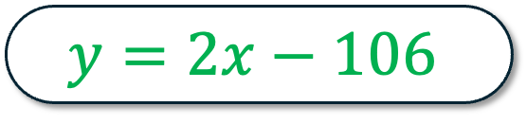
Click all the equations which are parallel to:
$$y=3x−1$$
$$y=10+2x$$
$$y=2x+3$$
$$y=5x+2$$
$$y=2x+5$$
$$y=2x−106$$
$$y=2x$$
$$x=2y+5$$
$$y=5$$
$$y=2x+3.56$$
$$y=x+2$$
$$y=2x−9$$

Slide 23
Problem-Solving Skill 1!
Find the equation of a line given a point and a gradient.
😊

Slide 24
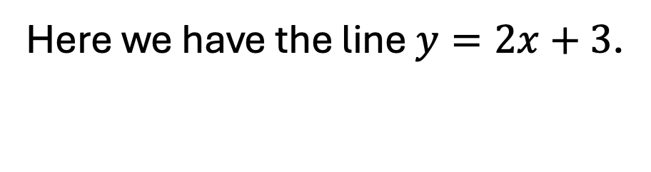

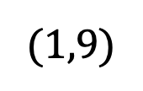
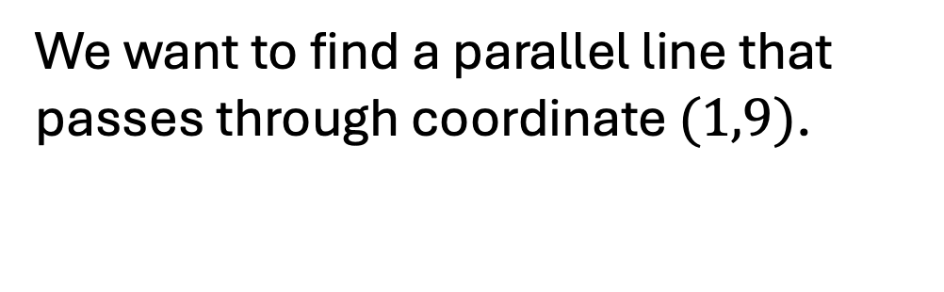
Teacher led worked example.
After worked example, emphasize each step (sub-goal learning model).
Here we have the line $y=2x+3$.
We want to find a parallel line that passes through coordinate $(1,9)$.
10
$$(1,9)$$
$$y=mx+c$$
5
-5
0
5
10
-5
Notes:
Teacher led worked example.
After worked example, emphasize each step (sub-goal learning model).

Slide 25
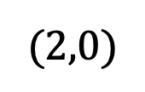
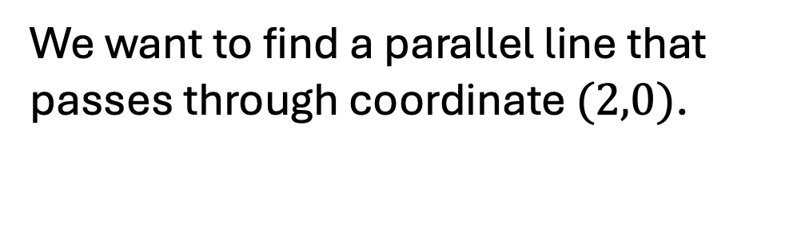
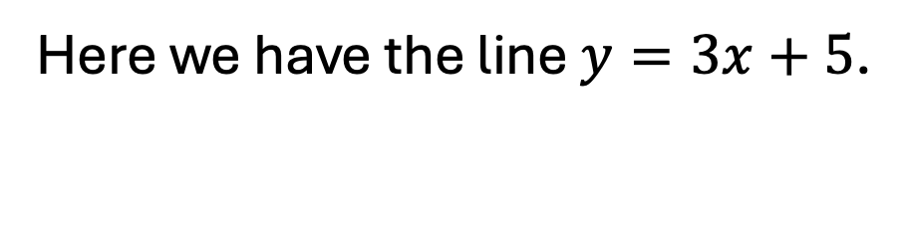
Here we have the line $y=3x+5$.
We want to find a parallel line that passes through coordinate $(2,0)$.
10
$$y=mx+c$$
5
the gradient is the same.
Parallel lines means that…
the y-intercept is the same.
-5
0
5
10
the x-intercept is the same.
$$(2,0)$$
-5

Slide 26


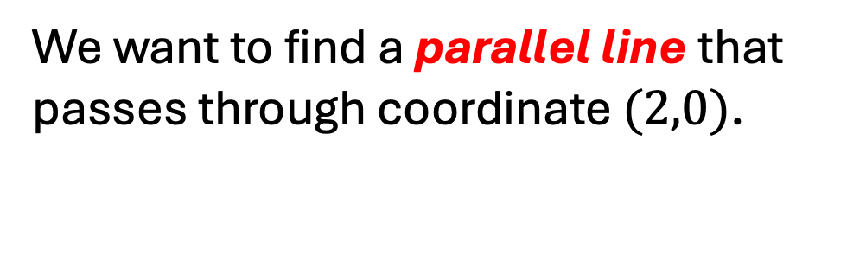
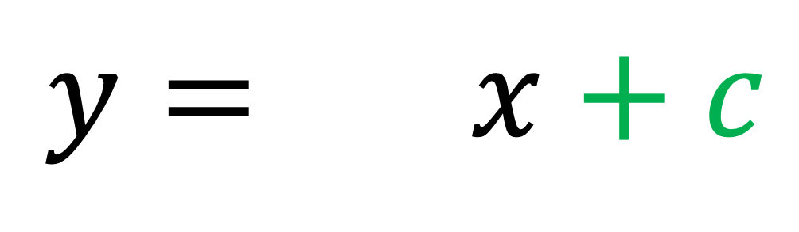
Here we have the line $y=3x+5$.
We want to find a parallel line that passes through coordinate $(2,0)$.
10
$$y=mx+c$$
5
$$m$$
Parallel lines means that the gradient is the same.
$$y= x+c$$
0
5
10
-5
$$(2,0)$$
-5

Slide 27



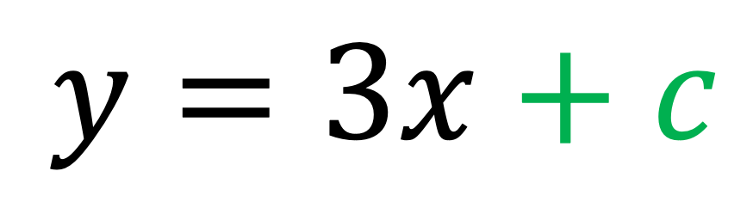
Here we have the line $y=3x+5$.
We want to find a parallel line that passes through coordinate $(2,0)$.
10
$$y=mx+c$$
5
$$m$$
Parallel lines means that the gradient is the same.
$$y=3x+c$$
$$3$$
0
5
10
-5
$$(2,0)$$
$$4$$
$$5$$
-5
$$0$$
$$1$$
$$2$$
$$−3$$
$$−2$$
$$−1$$
Notes:
Ask students to try substituting in the coordinate (2,0) into the equation on their miniwhiteboards. Only do the substitution right now.
Then ask them to solve the equation.

Slide 28
Here we have the line $y=3x+5$.
We want to find a parallel line that passes through coordinate $(2,0)$.
10
$$y=mx+c$$
5
-5
0
5
10
$$(2,0)$$
-5
Notes:
Clear slide for complete worked example if required.

Slide 29
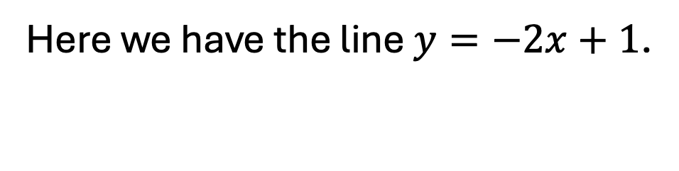
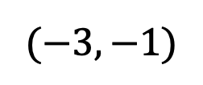
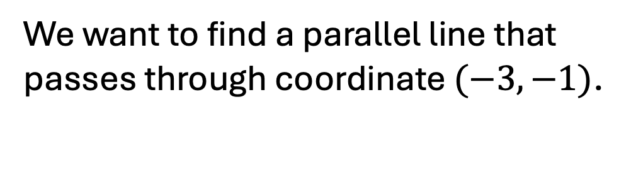
Here we have the line $y=−2x+1$.
We want to find a parallel line that passes through coordinate $(−3,−1)$.
10
$$y=mx+c$$
5
-5
0
5
10
$$(−3,−1)$$
-5
Notes:
Teacher choice how this is done:
A) scaffolded as before
B) No scaffold, all students have a go.

Slide 30
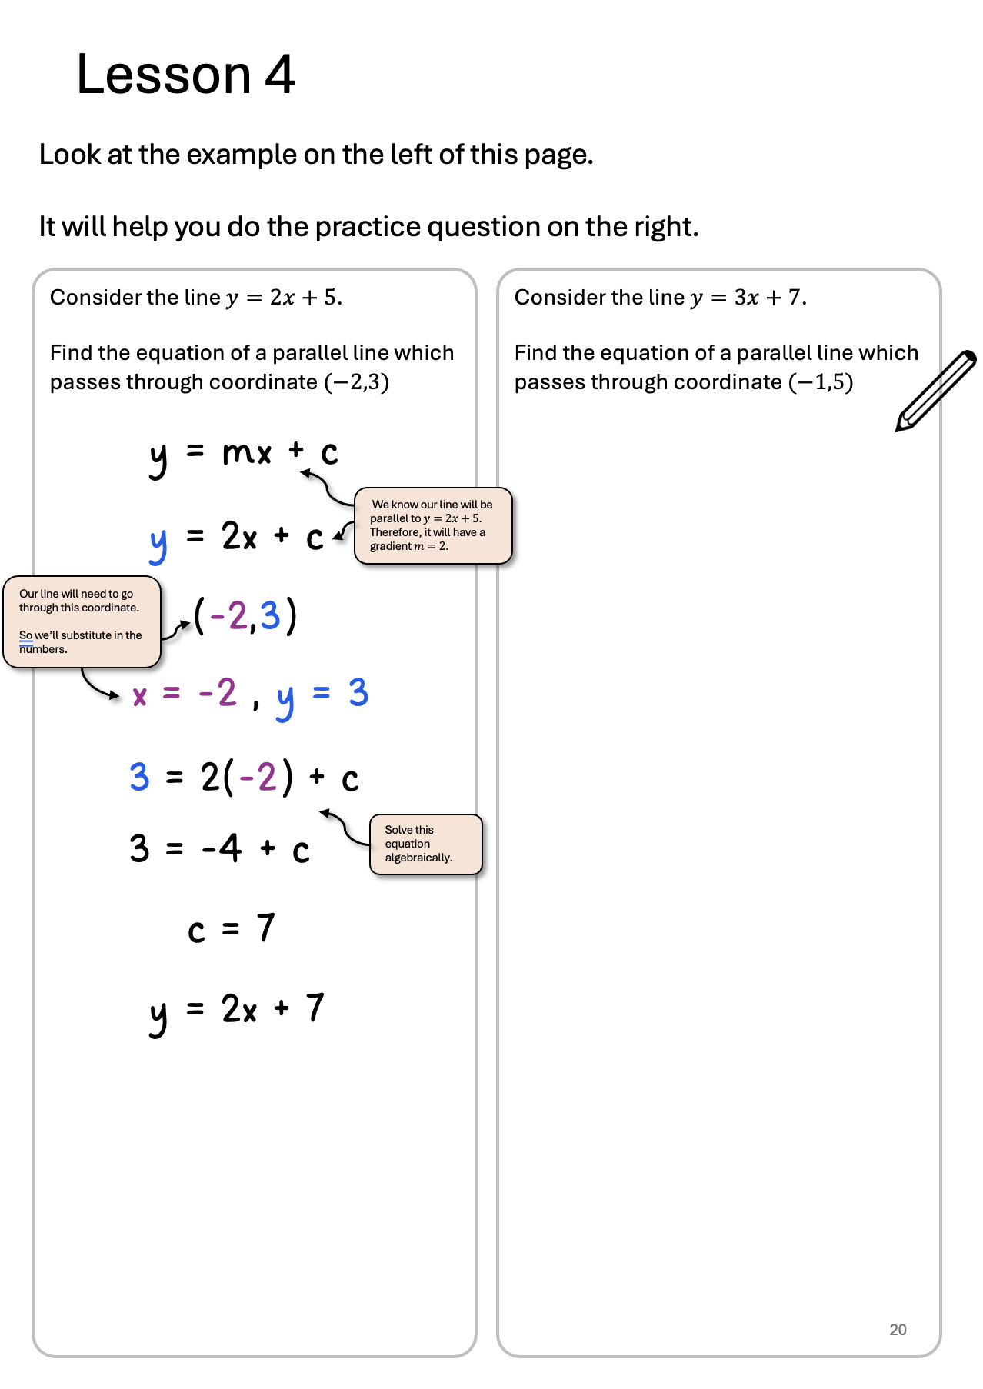
Turn to page 20 in your booklet and complete the questions on this page.
You must complete all questions and check your answers before continuing.

Slide 31
y = mx + c
y = 3x + c
(-1,5)
x = -1 , y = 5
5 = 3(-1) + c
5 = -3 + c
c = 8
y = 3x + 8

Slide 32


What is the gradient of this line?
$$(2,13)$$
A
Negative
Flat
C
Positive
B
$$(4,1)$$

Slide 33

Negative
The gradient is .
$$(2,13)$$
What is the value of the gradient?
$$y= x+c$$
$$(4,1)$$

Slide 34






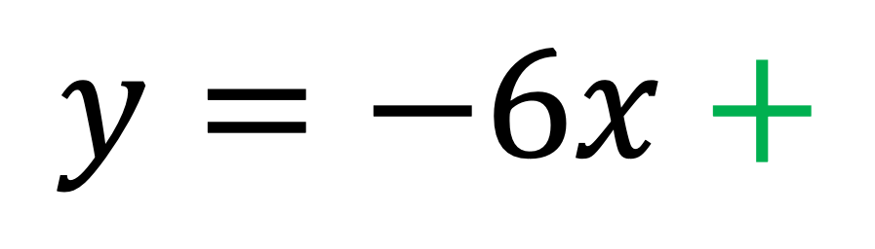
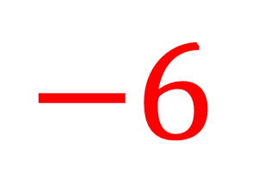


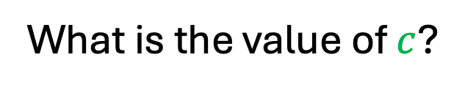
Negative
The gradient is .
$$(2,13)$$
What is the value of $c$?
$$−6$$
$$y=−6x+$$
$$−1$$
$$−2$$
$$−3$$
$$(4,1)$$
$$−4$$
$$−5$$
$$−7$$
$$−8$$
$$−9$$
Notes:
Teacher should hint that the students should substitute (4,1) into the equation.

Slide 35
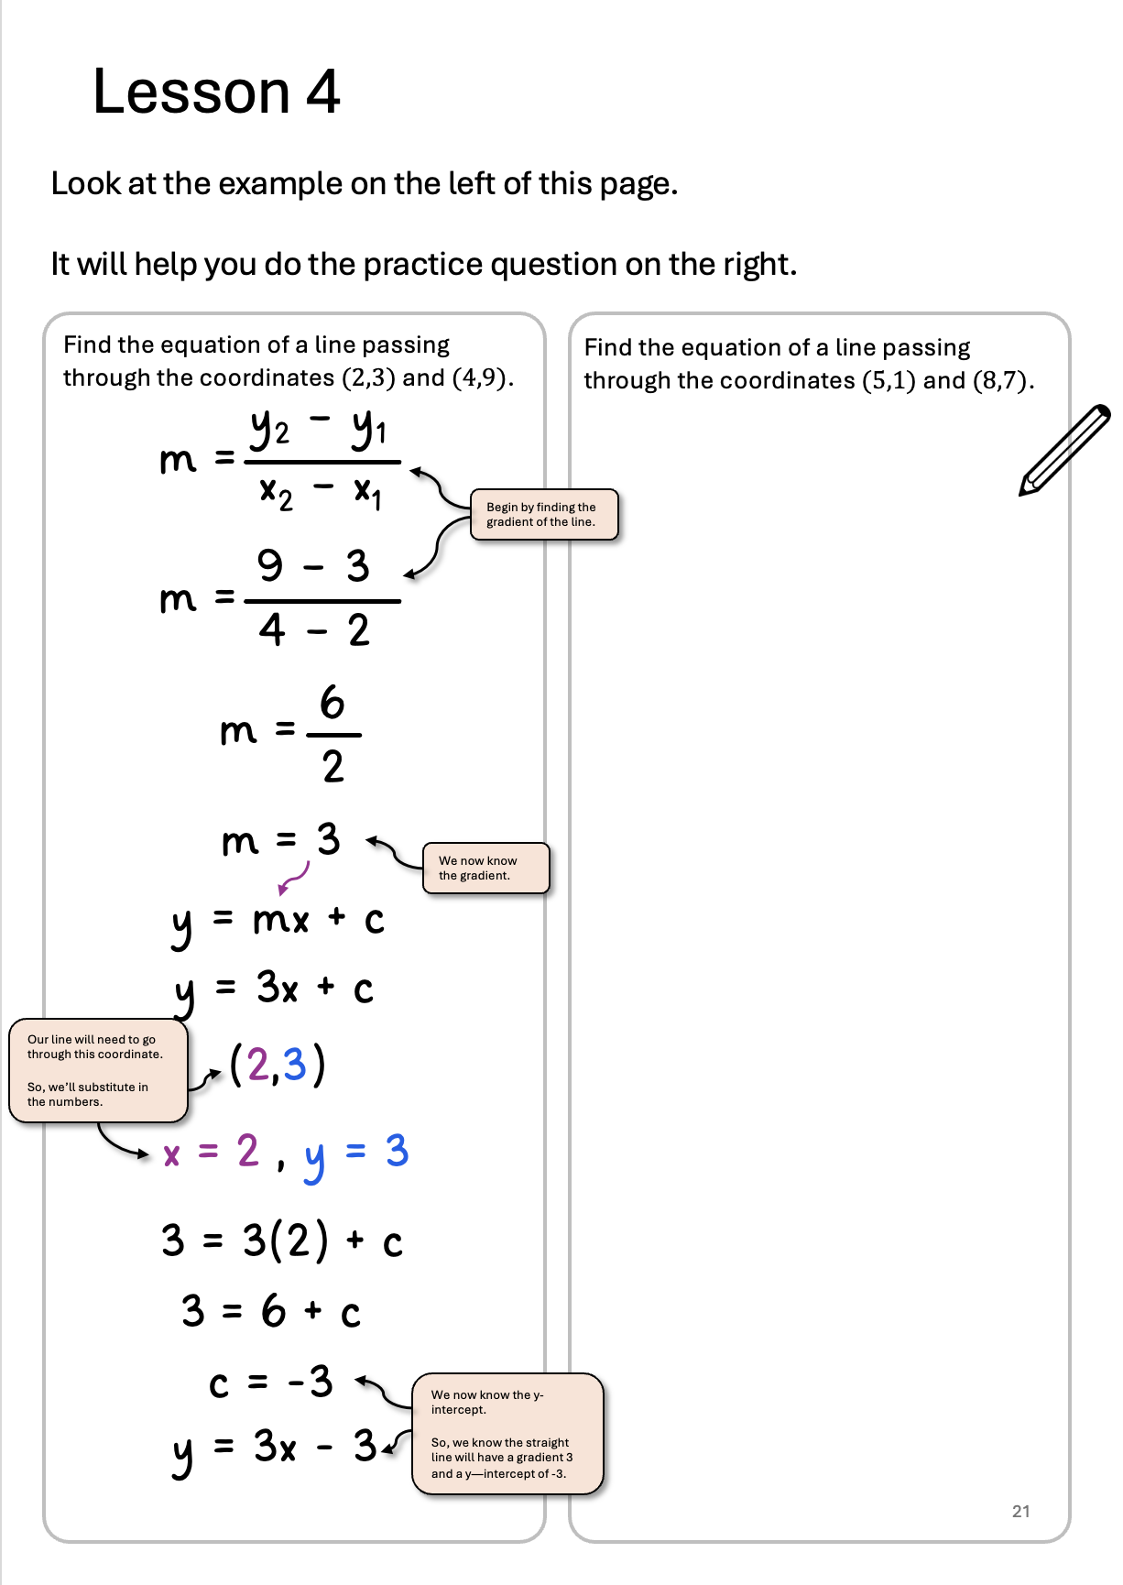
Turn to page 21 in your booklet and complete the questions on this page.
You must complete all questions and check your answers before continuing.

Slide 36
y₂ – y₁
m =
x₂ – x₁
7 – 1
m =
8 – 5
6
m =
3
m = 2
y = mx + c
y = 2x + c
(5,1)
x = 5 , y = 1
1 = 2(5) + c
1 = 10 + c
c = -9
y = 2x - 9

Slide 37
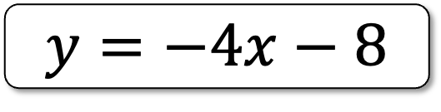
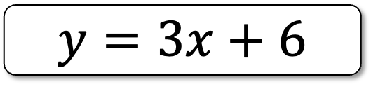
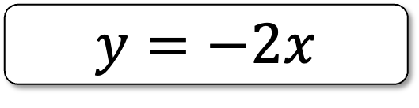
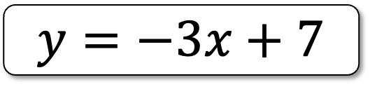


Look at the purple line.
Which of the following equations could match the line?
$$y=8$$
$$y=−2x$$
$$y=−3x+7$$
$$y=3x+6$$
$$y=4x$$
$$y=−4x−8$$

Slide 38







The $y$-intercept is positive.
We know this because it is above the $x$-axis.
Look at the purple line.
Which of the following equations could match the line?
$$y=8$$
$$y=−2x$$
$$y=−3x+7$$
$$y=3x+6$$
$$y=4x$$
$$y=−4x−8$$
The gradient is negative.

Slide 39






Look at the purple line.
Which of the following equations could match the line?
$$y=x+9$$
$$y=3x$$
$$y=−x+9$$
$$y=3x+9$$
$$y=9$$
$$y=−2$$

Slide 40








The $y$-intercept is positive
We know this because it is above the $x$-axis.
Look at the purple line.
Which of the following equations could match the line?
The gradient is flat, so $m=0$.
$$y=x+9$$
$$y=3x$$
$$y=−x+9$$
$$y=3x+9$$
$$y=9$$
$$y=−2$$

Slide 41






Look at the purple line.
Which of the following equations could match the line?
$$y=2x$$
$$y=−2x$$
$$y=5$$
$$y=−x+7$$
$$y=x+5$$
$$y=x−1$$

Slide 42







Look at the purple line.
Which of the following equations could match the line?
$$y=2x$$
$$y=−2x$$
The gradient is positive.
$$y=5$$
$$y=−x+7$$
$$y=x+5$$
$$y=x−1$$
The $y$-intercept is negative.
We know this because it is below the $x$-axis.

Slide 43






Look at the purple line.
Which of the following equations could match the line?
$$y=2x+1$$
$$y=4x$$
$$y=9$$
$$y=4x+1$$
$$y=3x−1$$
$$y=−4x$$

Slide 44






Look at the purple line.
Which of the following equations could match the line?
$$y=4x$$
$$y=2x+1$$
$$y=9$$
$$y=4x+1$$
$$y=3x−1$$
$$y=−4x$$

Slide 45







What could be the equation of the red line?
$$y=4x$$
$$y=4x$$
$$y=6$$
$$y=4x+6$$
$$y=2x+6$$
$$y=−4x+6$$
$$y=5x$$

Slide 46




What could be the equation of the red line?
$$y=4x$$
$$y=4x$$
$$y=\frac{1}{4}x$$
$$y=5x$$
$$y=2x$$
$$y=−4x+6$$
$$y=−4x$$

Slide 47






What could be the equation of the red line?
$$y=4x$$
$$y=4x$$
$$y=\frac{1}{4}x$$
$$y=5x$$
$$y=2x$$
$$y=−4x+6$$
$$y=−4x$$
c

Slide 48




What could be the equation of the red line?
$$y=4x$$
$$y=4x$$
$$y=−1$$
$$y=−2x$$
$$y=3x$$
$$y=3x+1$$
$$y=5x$$

Slide 49






What could be the equation of the red line?
$$y=4x$$
$$y=4x$$
$$y=−1$$
$$y=−2x$$
$$y=3x$$
$$y=3x+1$$
$$y=5x$$

Slide 50

Turn to page 22 in your booklet and complete the questions on this page.
You must complete all questions and check your answers before continuing.

Slide 51





$$y=3x+8$$
$$y=3x+3$$
$$y=x+6$$
$$y=4x$$

Slide 52

Turn to page 23 in your booklet and complete the questions on this page.
You must complete all questions and check your answers before continuing.

Slide 53



$$m=−2$$
Positive
$$m=0$$
Flat
$$y=3x+8$$

Slide 54

Turn to page 24 in your booklet and complete the questions on this page.
You must complete all questions and check your answers before continuing.

Slide 55



$$y=9$$
$$y=−3x+10$$
$$y=−5x+33$$

Slide 56









Lesson 1
Lesson 2
Lesson 3
Lesson 4
$$y=3x+1$$
We learned how to plot a straight-line graph using a table of values.
Step 1: Complete a table of values by substituting the $x$ values into the equation.
Step 2: Plot the coordinate pairs on a graph.
Step 3: Connect the coordinates with a straight line, using a ruler.
$$x$$ | $$−2$$ | $$−1$$ | $$0$$ | $$1$$ | $$2$$ | $$3$$
$$y$$ | $$−5$$ | $$−2$$ | $$1$$ | $$4$$ | $$7$$ | $$10$$
10
$$(3,10)$$
$$(2,7)$$
5
$$(1,3)$$
$$(0,1)$$
-5
0
5
10
$$(−1,−2)$$
-5
$$(−2,−5)$$

Slide 57




Lesson 1
Lesson 2
Lesson 3
Lesson 4
We learned about gradients and how to find the value of a gradient.
The gradient is a number which tells you how steep the line is.
$$m=\frac{change in y}{change in x}$$
$$m=\frac{y_{2}−y_{1}}{x_{2}−x_{1}}$$
$$(−1,8)$$
$$(2,2)$$

Slide 58




Lesson 1
Lesson 2
Lesson 3
Lesson 4
We learned that straight-lines have the equation $y=mx+c.$
y-intercept
The value of $c$ tells you the y-intercept.
$$y=mx+c$$
Gradient
The value of $m$ tells you the gradient.

Slide 59



Lesson 1
Lesson 2
Lesson 3
Lesson 4
Today we learned how to find the equation of a parallel line.
Parallel lines have the same gradient.
We also found out how to find the equation of a line through two points.
$$(2,13)$$
$$y=mx+c$$
$$(4,1)$$
$$y=−6x+25$$

Slide 60

You’ve completed all lessons!
Thank you for your hard work over the last 4 lessons!
You can work through the sudoku questions while the rest of the class catch up.

